Slide 1
Wiley Digital Archives: Latvia
Program overview: 2019

Slide 2
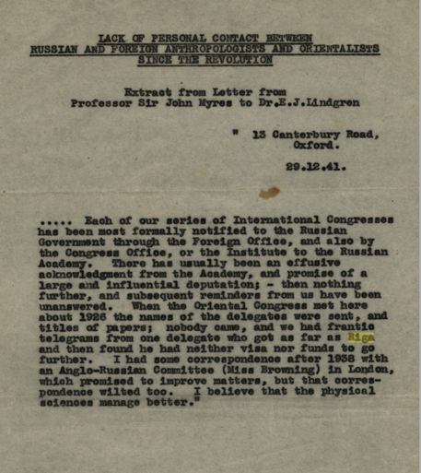
Agenda
Wiley Digital Archive Program Overview
Initial partners:
Royal Anthropological Institute
New York Academy of Sciences
Royal College of Physicians
History, mission and content
Research applications
Platform demonstration
Questions & answers
Myres, John. “Correspondence between Sir John Myres and Dr. E. J. Lindgren.” Lindgren Scientific Papers, 29 Dec. 1941. Wiley Digital Archives, http://WDAgo.com/s/36bfdcaa. Accessed 23 Jan. 2019. Royal Anthropological Institute.

Slide 3
What is Wiley Digital Archives?
Wiley Digital Archives is a long-term program of new, digital content sets comprised of unique or rare historical primary sources, digitized from leading societies, libraries, and archives around the world.
Online access to these collections will lead directly to:
Supporting current research initiatives
Achieving educational goals across a multitude of disciplines
Enhancing the research and classroom experience by bringing a unique, visual analysis to targeted search results and terminology

Slide 4
The Dilemma Primary sources included in the physical archives are:
Expensive for researchers to visit
Difficult to uncover
Challenging for students to access
Not available online
Typically requires a grant proposal, in addition to requiring weeks or months of time to visit the physical archive.
Due to the physical nature, storage, and age of the archives, items maybe difficult to uncover even while visiting the society library.
Unable access remote archives & unable to use important research in their work.
Need credentials or, otherwise, a blessing from faculty, archivists.
“No Results Found”

Slide 5
The Solution Making the archives accessible to researchers:
Offers a richer, holistic scholarly record
Adds historical context
Brings a wealth of new material
Increasing connections
Enables researchers and students to gain a closer understanding, or even reinterpretation of journal articles or scientific conclusions.
Contains the primary research and data which shaped the evolution of the sciences, across a range of disciplines.
For faculty, researchers, and students alike, altering the competitive research landscape, and changing the nature of education in these key fields.
as new collections are added to the scholarly record this enables researchers to examine large swaths of historical research through the lens of many disciplines.

Slide 6
The benefits of Wiley Digital Archives
As new and varied collections are added to the platform, WDA enables researchers to examine areas of interest through the lens of many disciplines.
Medical Issue
(Effects or Use of Radiation)
Scientific
perspective
NY Academy of Sciences
Medical perspective
Royal College of Physicians
Effects of radiation on indigenous peoples
Royal Anthropological Institute

Slide 7
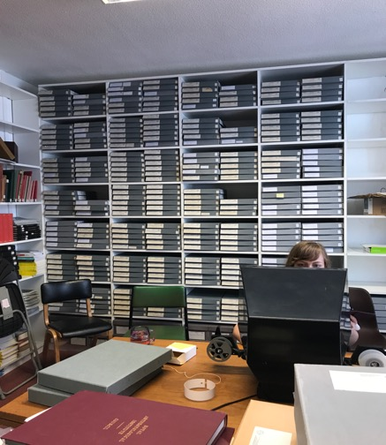
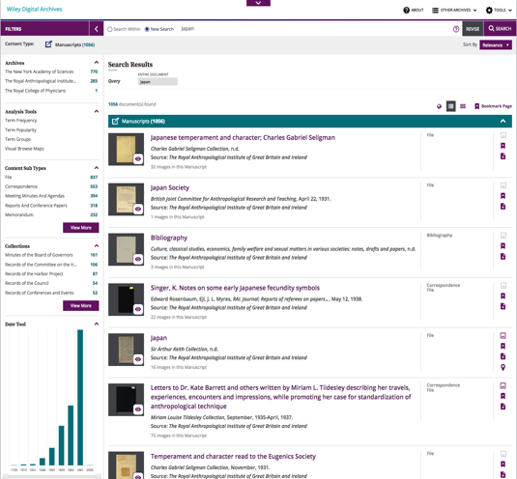
WDA Solves Problems and Meets Needs
Access
MEANINGFUL
Discovery

Slide 8
Full-text, browse-able searchable content includes primary sources across a range of formats:
Manuscripts
Maps
Administrative Records
Periodicals
Data
Monographs
Fieldwork
Correspondence
Photographs
Illustrations
Proceedings
Personal Papers
Reports
Grey Literature
Ephemera
Books
Blueprints
Newspapers

Slide 9
Royal Anthropological Institute of Great Britain and Ireland
History and Highlights

Slide 10
The Royal Anthropological Institute of Great Britain and Ireland
History and Goals : The Royal Anthropological Institute of Great Britain and Ireland
Founded in 1871, and with roots back to 1837, it’s the world’s longest-established scholarly association dedicated to the furtherance of anthropology (the study of humankind) in its broadest and most inclusive sense. Its distinguished tradition of scholarship stretching back over more than 180 years.
Goals and Activities
Committed to promoting the academic/student understanding of anthropology
Promotes the contribution of anthropology to public affairs
RAI publishes journals that circulate globally, about 70% circulation outside the UK
Gives awards for outstanding scholarship
Organizes lectures and conferences, and manages a number of trust funds for research

Slide 11
The Royal Anthropological Institute of Great Britain and Ireland
Content:
Majority of RAI archives*
Runs from ~1763 to 2016 (some material post-1967 is held back under privacy rules)
Range of content types
A great deal of uncatalogued material was “discovered” during the process!
*excludes a small amount of material held back by RAI. Catalog records in the database will reflect what’s omitted.

Slide 12
Key areas of research supported by the The Royal Anthropological Institute archives:
Colonial History
African
British Studies
ANTHROPOLOGY
Asian & Pacific
Gender & Ethnic Studies
Area Studies
Middle Eastern
Religion: Art, Dance
Latin American & Caribbean
Archaeology
North America
Cultural Studies
Photography

Slide 13
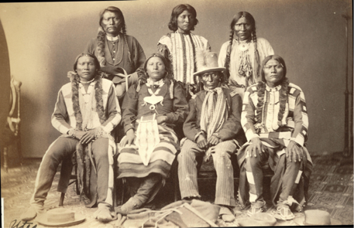
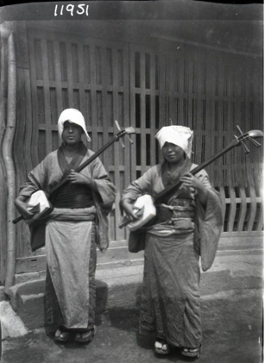
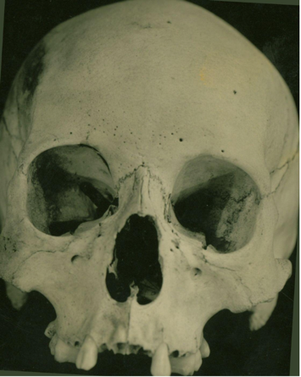
From the RAI Ethnographic Photographic Collections
Front Row, left to right - "John", Ma-ku-tcha-wo or Sa-pe-a, Cu-ra-can-te, Mose; Back Row, left to right - To-shi-my (Black Bear) OR Mexicano, Kwa-ko-nut "A King", Mexicano OR To-shi-my (Black Bear).
Hayden Album, 1873.
Street singers, Japan (The musical instrument is called 'samisen’).
Walter Leo Hildburgh, Hildburgh Collection, 1902 c.
Eskimo Skull from Bouthurust Inlet Coronation Gilf N.W. Territory. Canada, Young Man Named Kranzmalit Died about 1930, Collected by Rev. Father Raymond
Bentley Vancouver B.C, Photograph, RAI Photographic Library, 1945.

Slide 14
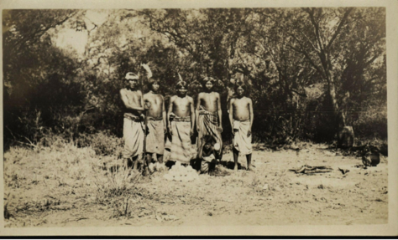
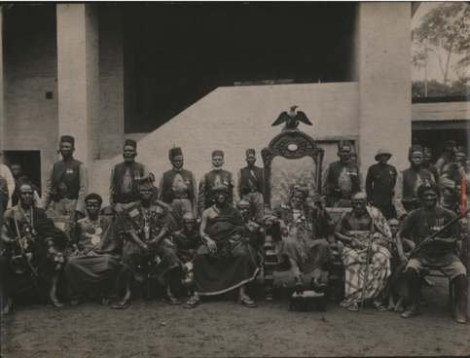
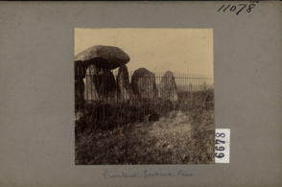
From the RAI Ethnographic Photographic Collections
Suhin Indians with pile of ostrich eggs before a feast.
Notes on the Indian tribes of the Paraguayan and Bolivian Chaco, n.d.
Kso Chiefs, Ghana.
Photograph, RAI Photographic Library, 1930.
Megalithic tomb, behind fence, Wales (UK).
Auden, Photograph, RAI Photographic Library, n.d.

Slide 15
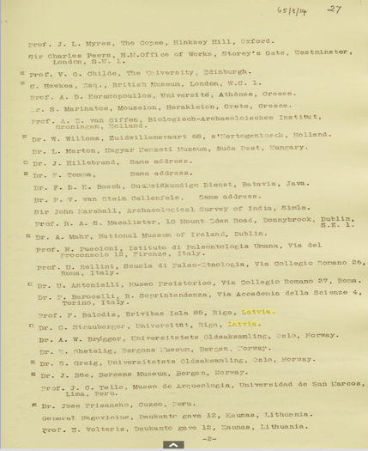
RAI Connections to Latvia
“List of Members of the Conseil Permanent.” International Congress of Prehistoric and Protohistoric Sciences, No Date. Wiley Digital Archives, http://WDAgo.com/s/e5128fcc. Accessed 23 Jan. 2019. Royal Anthropological Institute.

Slide 16
New York Academy of Sciences
History and Highlights

Slide 17
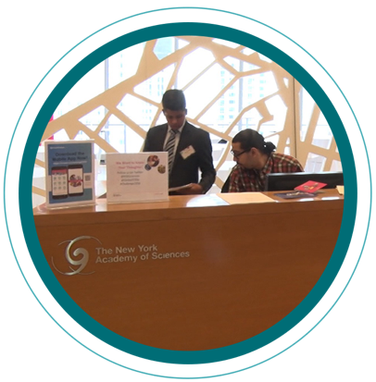
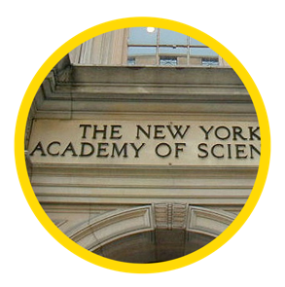
New York Academy of Sciences
History and Goals: The New York Academy of Sciences
This 200 year-old institution, founded in 1817, as the Lyceum of Natural History in the City of New York, with strong organizational connections to the New York Botanical Garden, the American Museum of Natural History, and New York University and New York Public Library.
Goals and Activities
Promote education in the sciences
Further the dissemination of scientific and medical research and information to the public
Bring individuals and organizations together to drive real-world solutions to global challenges
Publish: Annals of the New York Academy of Sciences,
one of the oldest scientific journals in the United States, and
among the top five cited multidisciplinary scientific serials worldwide.

Slide 18
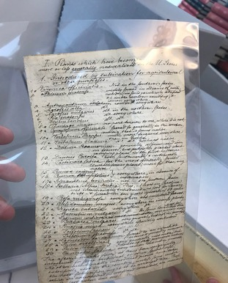
New York Academy of Sciences
Entirety of NYAS archives
Runs from 1801 to ~2013
Range of content types
Content is almost entirely unique, from new scanning
Covers the history and development of scientific and medical research in North America, and many international efforts

Slide 19
Key areas of research supported by the NYAS archives:
Medical Science
Climate Science
SCIENCES
Puerto Rico/Virgin Islands Survey
Natural Sciences
Botany Forestry
Two additional NY Botanical Gardens collections
Chemistry
NYBG Collections by
N L Britton &
L D Schweinitz
Ecology
Civil/Human Rights
Caribbean Studies

Slide 20
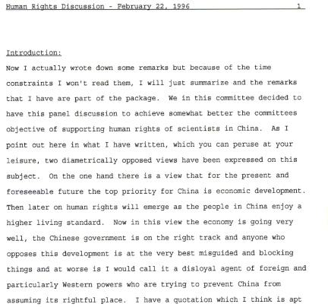
Collection Highlight: The Committee on Human Rights of Scientists
Civil/Human Rights
…was formed in 1978 to pursue the advancement of the basic human rights of scientists throughout the world. It intervenes in cases where scientists, engineers, health professionals and educators are detained, imprisoned, exiled, murdered, "disappeared," or deprived of the rights to pursue science, communicate their findings with their peers and the general public, and travel freely in accordance with established policies of The International Council for Science.”

Slide 21
Bridging archival research and contemporary issues
Ties in with current discourse:
anti-intellectualism sentiments which are being felt by universities and their scientists;
governmental and corporate influences around research related to the exploitation of natural resources, labor conditions, and the environmental and economic impacts of mining, drilling, etc.; and
funding challenges related to institutional efforts to track corporate activities impacting the environment.

Slide 22
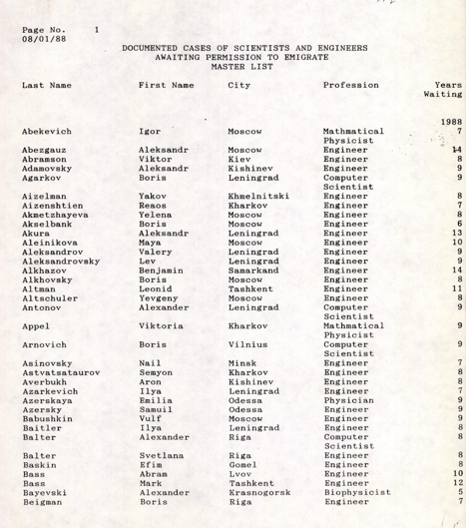
NYAS Connections to Latvia
“Soviet Union, January 7, 1988-March 15, 1991.” Records of the Committee on the Human Rights of Scientists, 7 Jan. 1988–15 Mar. 1991. Wiley Digital Archives, http://WDAgo.com/s/de9e7921. Accessed 23 Jan. 2019.

Slide 23
Royal College of Physicians
History and Highlights

Slide 24
The Royal College of Physicians
~2M page images, from new scanning, drawn from the archives and the Dorchester Library collections.
Over 6 centuries of medical history and medical humanities, from ~1300- ~1980.
Collections across a range of topics, including serving researchers and students in the areas of:
Medical Humanities
History/Philosophy of Science, Medicine, and Technology
Bioethics
Anatomy
Medical Law
Medical Policy
Non-Traditional Medicine
Non-Western Medicine
Medical Research (Disease/Treatment),
Military Medical Practices
British History
Colonial/Post-colonial history (Empire)
Public Health
Global Health Policy
General History Research
Gender Studies: Women in Medicine
Health Education
Health and Human Rights
Health Economics
Tobacco-related topics,
Medical and Biological Illustration,
Medicine or Science and the Humanities
Social Factors in Health
Religion and Medicine
History of Mental Illness
History of Pharmacology
Cultural and Social History
Medieval Studies
Early Modern Studies
18th-20th century Studies
History of Education

Slide 25
Royal College of Physicians—The Wiley Project
Wiley has partnered with the RCP to digitize approximately two million images of content drawn from the RCP archives and the Dorchester Library.
The archives and library probably total closer to 20M, and we are looking at a selection of content, guided by the Royal College of Physicians and academics and scholars, with input from Wiley.
Our advisors are:
Tilli Tansey, OBE, Emeritus Professor of the History of Modern Medical Sciences (QMUL), world-leading medical historian and Honorary Archivist at The Physiological Society, Honorary Fellow of the Royal Society of Medicine, Honorary Fellow at the Royal College of Physicians
Jacob Steere-Williams, Assoc. Professor, Department of History, Director, Public Health B.A., College of Charleston and Book Reviews Editor, Journal of the History of Medicine and Allied Sciences
Pamela Forde, Archive Manager, at Royal College of Physicians
Katie Birkwood, Rare Books and Special Collections Librarian at Royal College of Physicians

Slide 26
Key areas of research supported by the RCP archives:
History
Vaccination
Medical Humanities
Medicine
Disease
History of the RCP
Public Health
Law, Regulation, Policy, and Control
Military Medicine
World Health
(19th C Questionnaires)
Early and Medieval Texts
Early Medical Textbooks and Education
Anatomical Studies
Non-Western Medicine

Slide 27
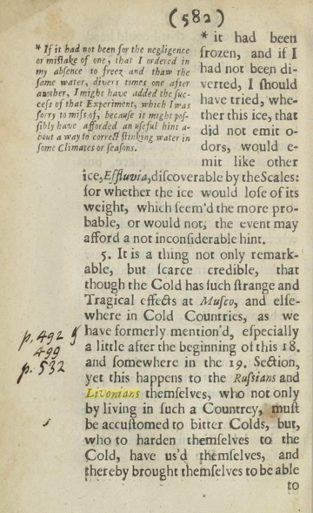
RCP Connections to Latvia
Merret, Christopher, and Robert Boyle. “New Experiments and Observations Touching Cold, … [With] an Account of Freezing….” Dorchester Library, J. Crook, 1655. Wiley Digital Archives, http://WDAgo.com/s/11441858. Accessed 23 Jan. 2019. Royal College of Physicians.

Slide 28
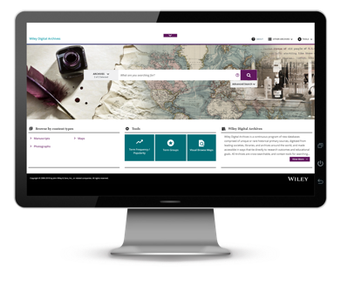
Platform Benefits
Full Boolean search functionality
Fuzzy logic searching, Proximity Searching
COUNTER-compliant usage statistics
MARC Records included
Interface available in multiple languages
Free delivery of content for Data Mining
Rights Management connection through the platform
Search call to Wiley Online Library from the homepage of WDA
Discoverable in EDS, Summon, Primo…
Metadata shared with discovery vendors after the loading process

Slide 29
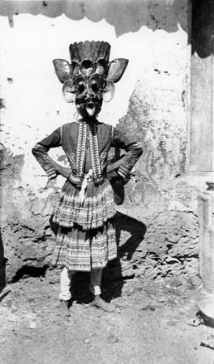
Wiley Digital Archives: Access Information
Institutional access
FTE-based pricing
Unlimited users
One-time purchase
No on-going fees
Product Training
For both Library & Faculty
"The dress is red, with white embroidery and consists of a jacket, long underskirt and shorter overskirt. The mask is wooden. Visible traditional Colombo area patterns: triangles. The devil's red dress with garuda (mythical bird) and snake mask. The devil dancer- a professional astrologer.“
Sinhalese devil's costume, Sri Lanka. Hildburgh, Walter Leo. 1903-1904 c.

Slide 30
Thank you!
Questions?
Would you like to receive information regarding future collections?

