Slide 1
Literature Online (LION) on the ProQuest platform - Overview
Trainer’s name
January 1, 2019

Slide 2
Session Objectives
At the end of the session, you will be able to
Differentiate the various content types based on your research needs
Discover relevant related resources from the Author record page
Use the Word Variants feature for language history researches
Evaluate and refine the search results
Notes:
1 - explore the homepage and find available LION collections in your institution subscription
2 – The author page is reached from the limiter in Basic search.
3 - Show how to Use word variants searching
4 – which unique features PQ provides to evaluate the results in dedicated Results pages. in addition, for primary texts Evaluate them by navigating keywords in docview and mention the Enhanced save options

Slide 3
Different Content Types for different research needs

Slide 4
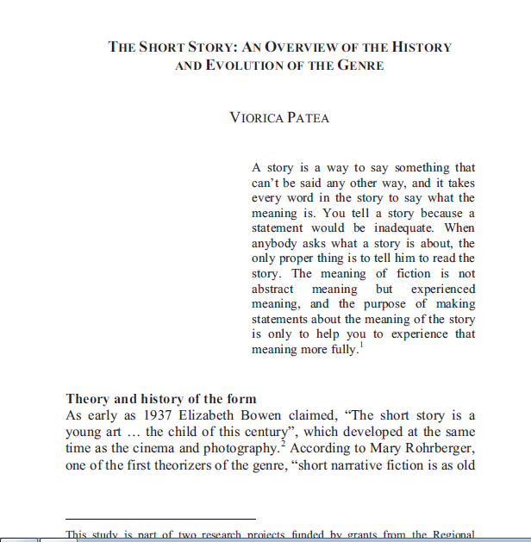
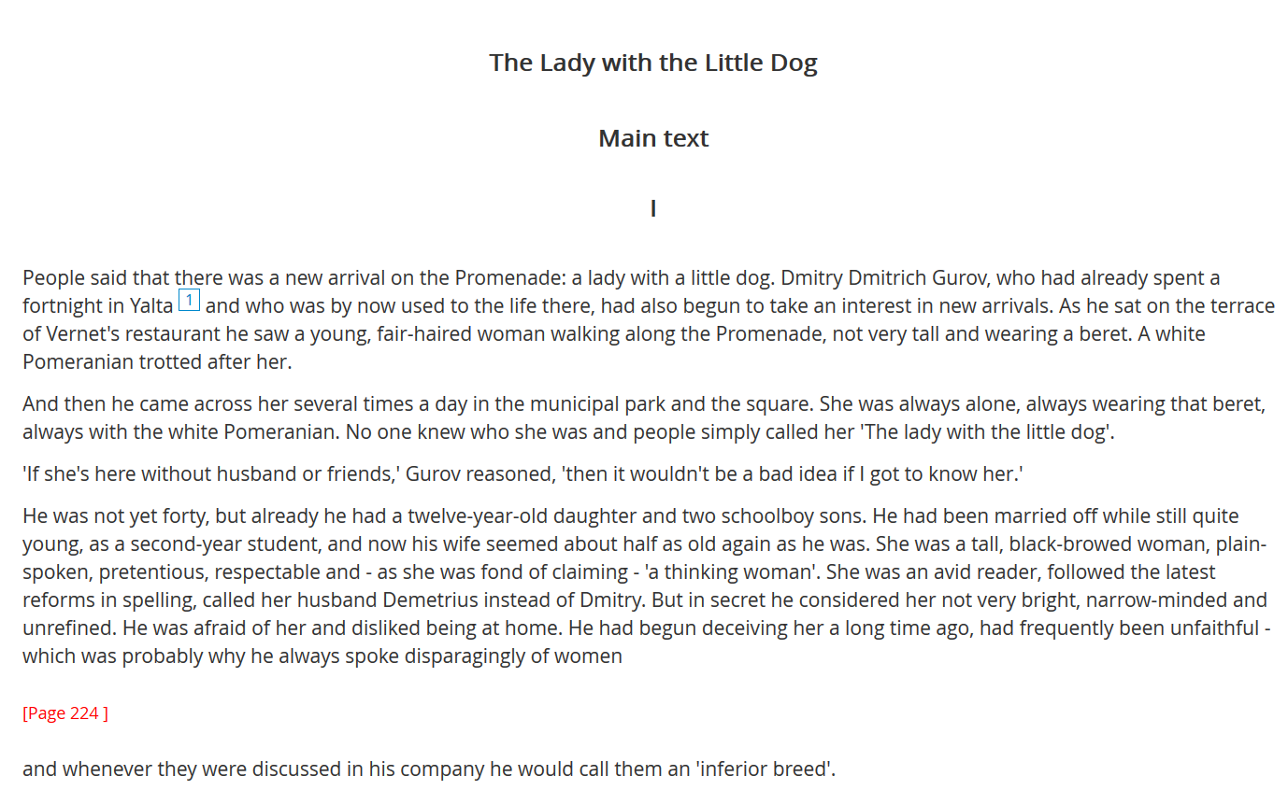
Literature Online (LION)
The Vision
Growing resource for
All aspects of literary research and teaching
Depth and quality of the material to
Cover every topic with confidence.
Notes:
An award-winning, constantly growing resource for all aspects of literary research and teaching, LION lets you use your time more effectively to analyze texts, appreciate context and focus on your point of view.
The depth and quality of the material, from Beowulf to Pulitzer and Nobel winners, ensures that students and teachers can cover every topic with confidence.
no undergraduate should do without it
no student should consider their research comprehensive without it

Slide 5
Different needs for different levels of users
NEEDS
SOLUTIONS
Scholarly researchers—graduate level & faculty—need to perform powerful philology and history of language researches on the evolution of texts, words, or concepts across centuries
Trace word usage and frequency over a vast corpus of highly textually accurate works; find all plays featuring Medea; trace changes in poetic sentiment over time to the fly; explore the implications of the use of “thou” and “you” in Renaissance texts.
Undergraduate researchers need fast access to easy overviews of writers and their works, of literary movements and periods, and experience the impact of live poetry and drama performances
They will benefit from a large collection of reference resources, encyclopedias, biographies and bibliographies as well as multimedia content that engages their attention
Librarians need to perform researches for their patrons over authoritative scholarly journals for relevant criticism research and reviews over authors, their literary productions, or periods and movements
Access to a vast repertoire of criticism literature and over 450 Full Text Journals will provide contextual insights into the latest research achievements on classic and modern writers
Notes:
Trace word usage and frequency over a vast corpus of highly textually accurate works; find all plays featuring Medea, trace changes in poetic sentiment over time to the fly, explore the implications of the use of “thou” and “you” in Renaissance texts.
Find relevant criticism by searching the Annual Bibliography of English Language and Literature (ABEL); a unique capability in LION.
See and hear poets like Susan Howe, Christopher Logue and Paul Muldoon reading their own and others works.

Slide 6
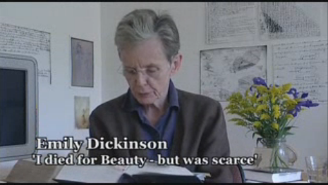
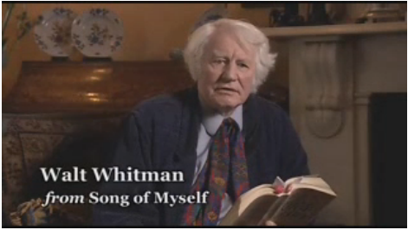
LION Core Collection
Primary Works
  A library of over 350,000 primary works of poetry, drama and prose dating from the 8th Century to the present day represent the essential canon of Anglophone Western Literature
Criticism resources
Essential Reference content
Audio and video material
Used by literary scholars all over the world on a daily basis for all aspects of literary research and teaching
Notes:
Brief overview on what is in LION.
You should all be pretty familiar with this; LION is the cornerstone of our Literature offering, has been around, ever-growing for over 20 years, and is relied upon by students, faculty and librarians on a daily basis in nearly 900 institutions globally

Slide 7
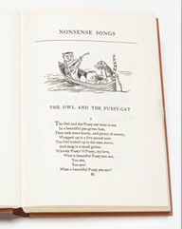
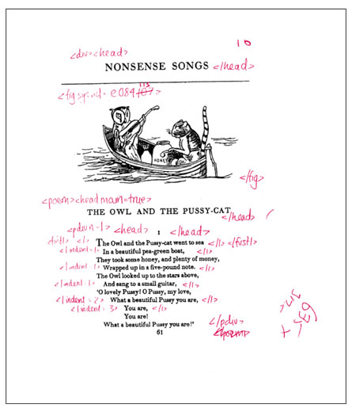
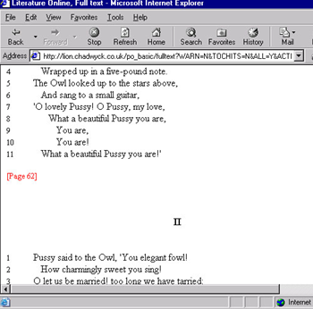
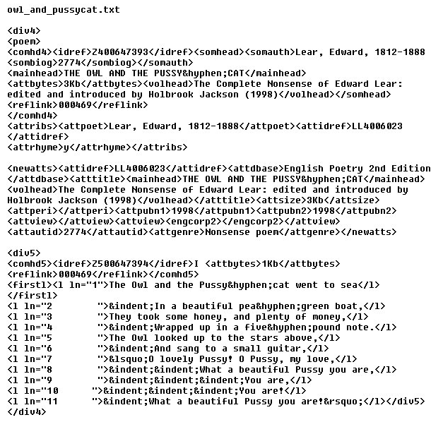
Primary Works: authoritative, accurate keying process
2. Text is hand coded in SGML, and re-keyed twice
1. Most authoritative edition selected
.
.
.
.
.
4. Product testing and upload to www to 99.97% accuracy
3. Scanned images and code proof-read
Notes:
THIS KEYING PROCESS IS UNIQUE TO PROQUEST
SEARCHABILITY OF PRIMARY WORKS IS UNIQUE TO PQ
A copy of this is marked up in code by our editorial team, then re-keyed – twice – by different operators, and the two versions compared by computer programme.
The code is checked and double checked, the keying proofed, and re-proofed. When we’re happy that our accuracy rate is as high as it can possibly be, data is passed to our software, design and product assurance teams, who build the databases, test and re-test them to provide an end-product looking something like this:
Original Text – with the reproduced coded text faithful to the original edition.
This lengthy, detailed production process applies to all our full-text databases. It is this accuracy, detailed indexing, cross-searchability, browsing and navigation, combined with the depth and breadth of our content, which makes our humanities databases so indispensable to the academic community.

Slide 8
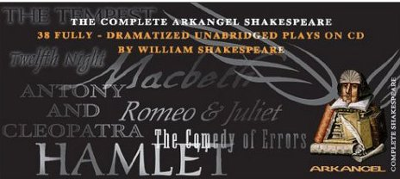
Primary works – Multimedia Contents
BBC Arkangel Shakespeare
All 38 of Shakespeare's Plays in dramatized Audio recordings
Shakespeare Audio Plays brings all of the Bard’s works to life in fully dramatised, unabridged versions.
“A rhapsody of words, assembled for the ear. This venture marries scholarship and accessibility on an unmatched scale. The real strength lies in the astonishing intimacy offered by a sound recording.” The New York Times
Notes:
THIS MULTIMEDIA CONTENT IS UNIQUE TO PQ
The BBC Arkangel edition of the complete works of Shakespeare contains 38 dramatic audio recordings of all of the Bard’s plays. In keeping with our editorial policy of offering authoritative and accurate original texts, the recordings are complete and unabridged and feature many noted Royal Shakespeare Company actors.
The the audio files will be integrated into the full text, allowing users to read the text of the plays while listening to the recordings. Just like our 900 Poets on Screen readings, this content is unique to ProQuest.

Slide 9
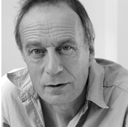
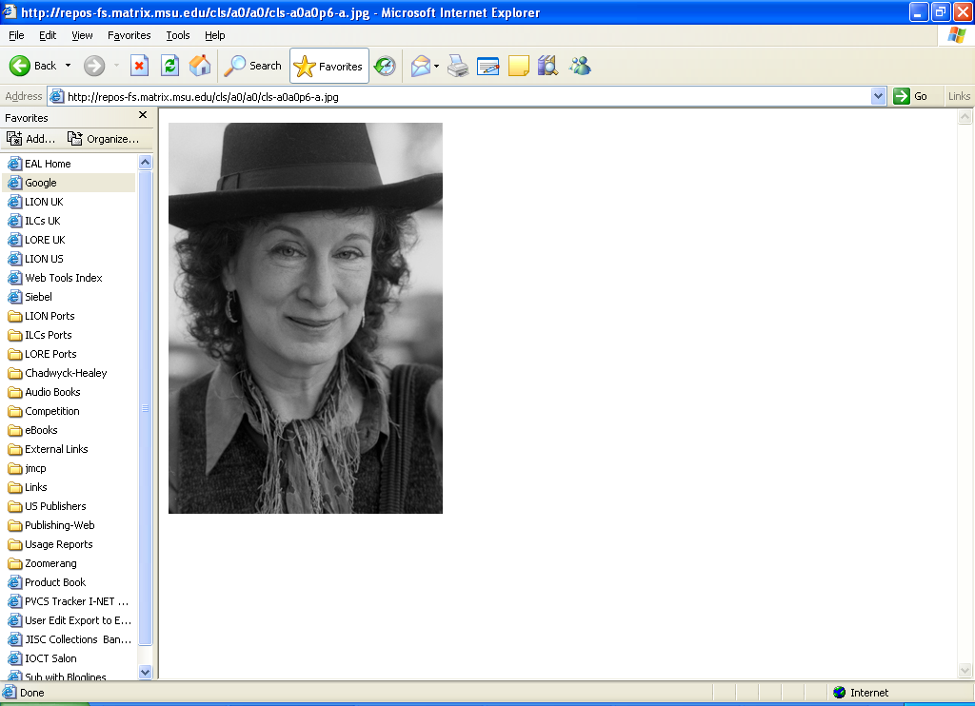
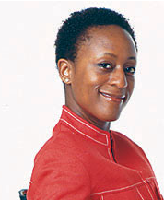
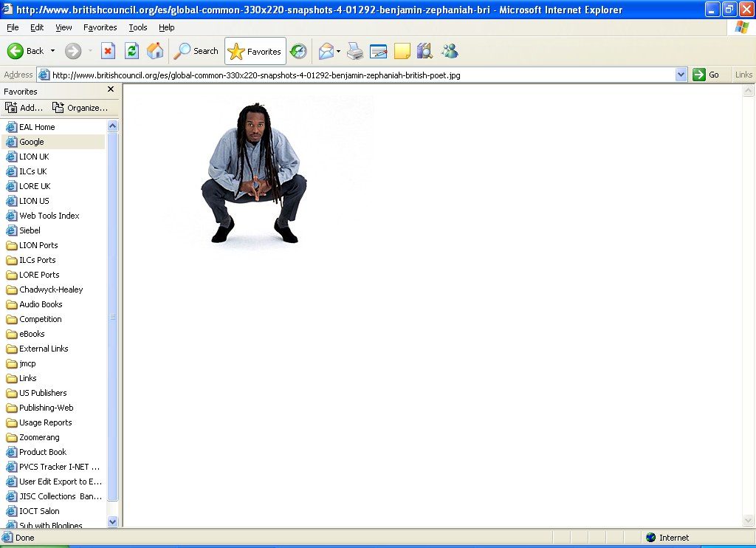
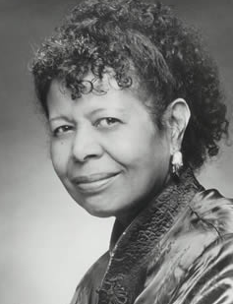
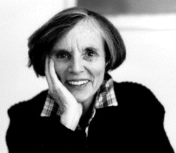
Primary works – Multimedia Contents
Poems read by Tom Paulin, Patience Agbabi, Margaret Atwood, Benjamin Zephaniah, Susan Howe, Jayne Cortez and many others
Poets on Screen:
A multimedia database of over 900 video recordings of poets reading their own and other’s works
specially commissioned clips of poets reading and discussing their own and others works
multi-media content creates a stimulating teaching resource that offers a unique opportunity to hear major authors reading and discussing works.
Notes:
Coming Soon! Poetry Archive audio links in Literature Online
Literature Online already offers nearly 900 video clips of poets reading their own and others’ works. Now we’re expanded our offering of poetry multimedia by incorporating links to the freely available audio recordings at The Poetry Archive. The Poetry Archive is the brainchild of Andrew Motion, the former British Poet Laureate, who was concerned that high quality audio recordings of contemporary poets reading their own works might be lost for posterity. The Poetry Archive was thus established to create recordings of important contemporary poets based on the belief that such readings are a powerful source of insight, understanding and enjoyment. As well as creating brand new recordings, the Archive also gathers together and preserves historic and hard to find recordings of long dead poets. So, the Archive enables listeners to hear the works of contemporary poets such as Billy Collins, Carol Ann Duffy and Michael Longley alongside historic recordings of Edmund Blunden, E.E. Cummings, Sylvia Plath and many more.

Slide 10
Criticism and Reference Content
Comprehensive library of literary criticism, all of recognised academic quality and scholarly value.
Literary works from top literary journals bring you the latest contemporary writing in English from authors worldwide.
Biographies and other reference material help place authors in context and to follow up connections with other authors and themes.
MHRA’s Annual Bibliography of English Language and Literature (ABELL)
index of articles, monographs and dissertations from 1920 to present
430+ current Literary Scholarly Journals in Full-Text, many with images
Backfile extends back to late 1980s in some cases
Dictionaries: Oxford, Shakespeare Glossary
Encyclopedias: Princeton Poetics, COD Literary Terms
6,000 Biographies + 1,500 Bibliographies
230 KnowledgeNotes – Study Guides for core texts
38 volumes of New Essays on the American Novel
200+ volumes Companions to Literature series (CUP)
More texts from CUP, OUP, Princeton UP, Routledge etc
Notes:
Growing number of bi- or multi-lingual journals brings the newest and the best writing about non-Anglophone (French, German, Spanish, Italian) literature to the user.
Reference Resources
essential encyclopedias and companions covering a range of important and often-studied genres and national literatures. Oxford University Press’s Companion to Irish Literature and Concise Companion to English Literature are available and offer useful introductions and surveys of the history of both national literatures.
Covering African and American literature are University of Florida Press’s Handbook of African American Literature, Routledge’s Encyclopedia of African Literature and Twentieth-Century Latin American and Caribbean Literature, 1900-2003. Additionally, Literature Online’s support of literary theory and linguistics is significantly enhanced with the inclusion of the Routledge Encyclopedia of Narrative Theory and the two volume Encyclopedia of Linguistics.
Another prestigious alignment for LION. Further associates us with the key creators of essential study and research resources.
Cambridge University Press Companions to Literature
220 volumes ( c. 3,300 essays) at completion
Valuable for undergraduates – provides essential introduction to current research on a theme, genre or author
Covers new areas of the curriculum
International and Contemporary
British and American
European works in translation
African, Commonwealth, ANZ, South American
Around 40% of LION’s primary works from 20th century.
Nearly 17,000 literary works in journals dating from 1945 to 2012 – to stress the contemporary content.

Slide 11
Literature Online Premium - the concept
LION Premium
BLACK WRITING COLLECTION
WORLD LITERATURE COLLECTION
LION
Core Collection
Notes:
Concentrating on the LION Premium offering:
All on the same platform. Fully integrated experience.
Simplified structure to cut out the complexities of the vast and varied Literature & Theatre portfolio so that we can focus on LION and LION Premium upgrades

Slide 12
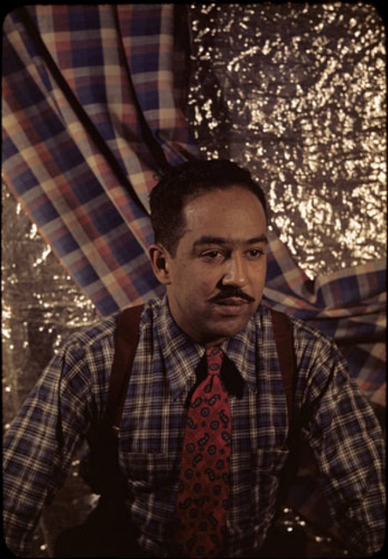
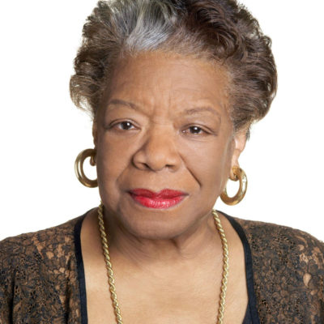
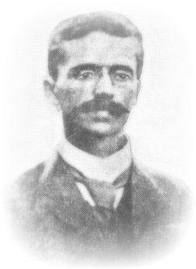

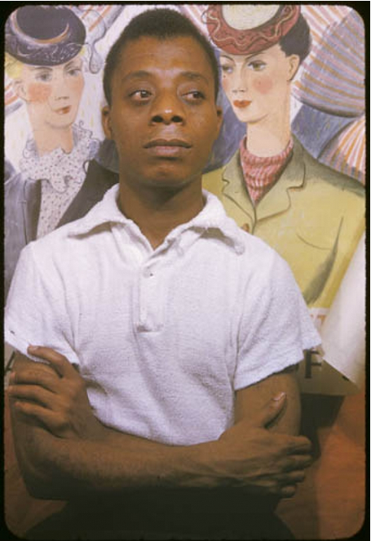
Introducing Black Writing Collection
The most inclusive library of Black Writing ever assembled – over 60,000 poems, plays, prose works, ephemera and fugitive texts by over 4,000 authors from more than 50 countries – the most important as well as the most forgotten voices.
Over 500,000 pages of out of print and in demand literature covering every facet of the African and African Diasporic experience from the 18th Century to today (much of it online for the first time)

Slide 13
Black Writing Collection: The Contents
Black Short Fiction and Folklore, Black Women Writers, Caribbean Literature; 300K pages of rare, hard to find, often forgotten or overlooked Black writing
Black Drama, Third Edition; 1,700 plays, published and previously unpublished, from Africa and the African Diaspora
50K works of previously undigitized prose and poetry from the 18th, 19th and early 20th centuries. Works long overlooked by anthologies
The Black Writing Collection permits unprecedented access to hundreds of thousands of unheard Black voices from around the world
Notes:
Vast majority of the Collection made up of previously unavailable material.

Slide 14
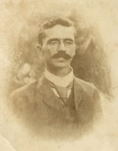
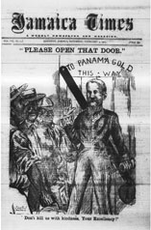
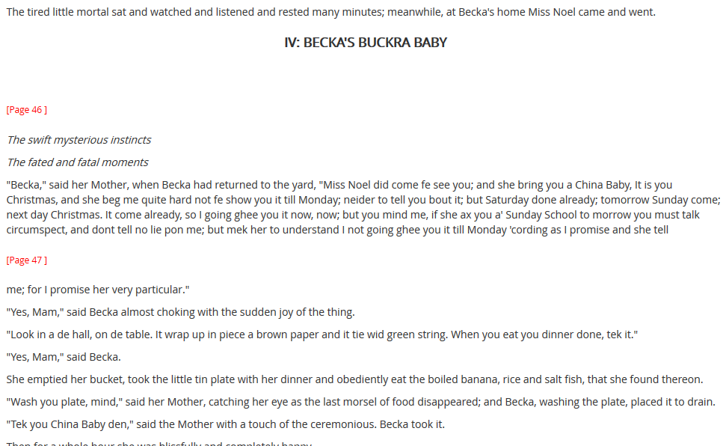
Black Writing Collection: A Case Study
Inclusion of rare and ephemeral voices.
Thomas MacDermot (1870-1933)
Journalist, author, poet, editor of the Jamaica Times.
Founder of the All Jamaica Library imprint of books by and about the island.
Posthumously proclaimed Jamaica’s first Poet Laureate
His novel Becka’s Buckra Baby (1904) considered to mark the beginning of modern Caribbean writing.
One posthumous collection of poetry and two novels
With launch of Black Writing Collection, LION now offers MacDermot’s complete works in one place for the first time.
Notes:
As literary studies grows increasingly interdisciplinary and with researchers needing to explore more consistently beyond the boundaries of traditional sources, Black Writing offers unprecedented opportunities to improve research with the inclusion of rare and ephemeral voices.
Thomas MacDermot (1870-1933)
Journalist, author, poet, editor of the Jamaica Times.
Founder of the All Jamaica Library imprint of books by and about the island.
Posthumously proclaimed Jamaica’s first Poet Laureate
His novel Becka’s Buckra Baby (1904) considered to mark the beginning of modern Caribbean writing.
One posthumous collection of poetry and two novels
With launch of Black Writing Collection, LION now offers MacDermot’s complete works in one place for the first time.

Slide 15
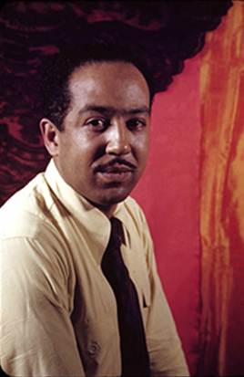
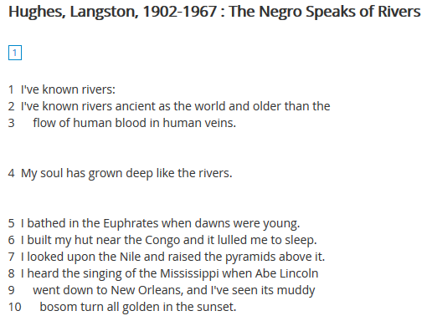
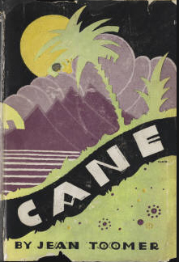
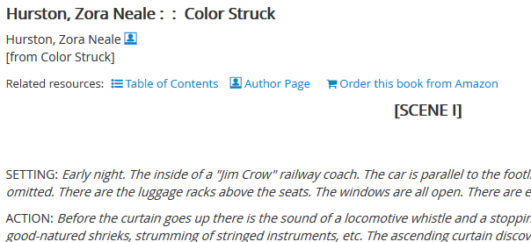
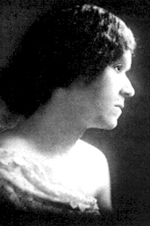
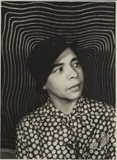
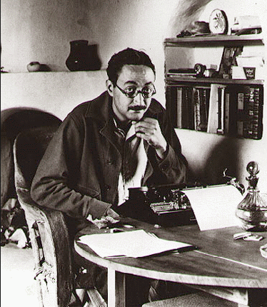
Black Writing Collection: more cases
Understand literary movements like the Harlem Renaissance in more depth and breadth than ever before.
Langston Hughes’ poetry meets his complete plays as well as those of Zora Neale Hurston and James Weldon Johnson
Jean Toomer’s masterpiece Cane (1923) joins his collected poems
Georgia Douglas Johnson’s and Nella Larsen’s poetry alongside extensive, exclusive biographies and a host of interpretive journal articles and reference material
Notes:
LION has Hughes poetry, but not drama. Or the works of Hurston – including Mule Bone (1930) a play they collaborated on and which broke their relationship.
LION has Toomer’s Collected Poems but not his 1923 prose masterpiece Cane.
These missing components, as well as the writings of lesser known but no less significant members of the movement are now available in LION Premium,

Slide 16
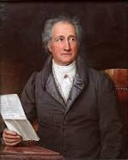
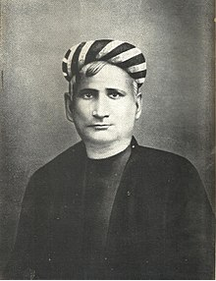
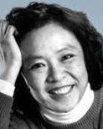
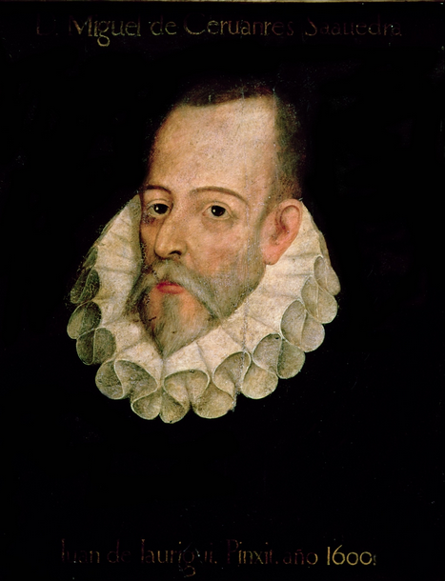
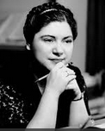
Introducing World Literature Collection
The world of Literature mapped in all its diversity and depth – more than 60,000 texts by authors of over 65 nationalities from Germany to Jamaica and Venezuela to Vietnam – the non-Anglophone literary canon assembled for the first time online.
Build upon the 1,000 years of established Anglophone literary tradition with works in Spanish, French, Dutch and Papiamento (to name a few) including texts in native languages and in translation.

Slide 17
World Literature Collection: The Contents
South and Southeast Asian Literature, Latino Literature, Latin American Women Writers; 200K pages of essential post-colonial writing in English and native languages
CH German Literature collections; 45,000 works of German literature dating back to Martin Luther, featuring Goethe’s as well as Bertolt Brecht’s complete works.
Teatro Espanol del Siglo de Oro, and newly licensed contemporary Spanish poetry, prose and drama; almost 8,000 of the most important literary works in Spanish and Portuguese from the 17th century to the present day
The World Literature Collection allows researchers to thoroughly chart the global literary map for the first time; appreciating the translation of ideas, traditions and influences across time and place
Notes:
German Literature Collections migrating to PQP as part of World Literature Collection in 2019.

Slide 18
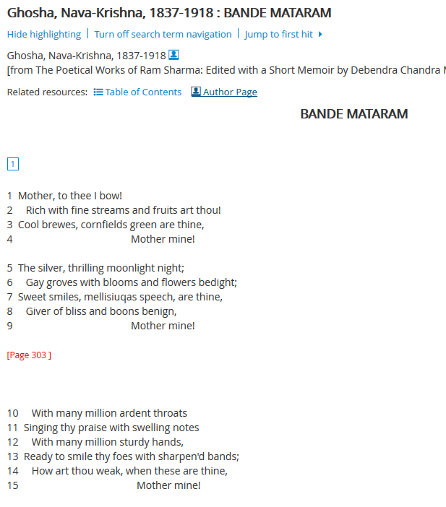
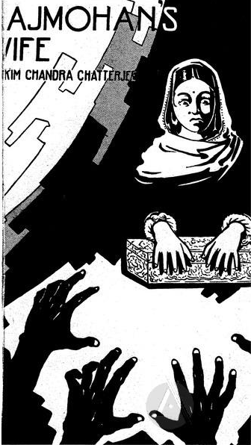
World Literature: A Case Study
Inclusion of rare and non-Anglophone voices
Bankim Chandra Chatterjee (1838-1894)
Composer of India’s national song, Vande Mataram which inspired activists during the Indian Independence Movement (1857-1947) when set to music by Rabindranath Tagore.
A key figure in the literary renaissance of Bengal as well as the broader Indian subcontinent
With launch of World Literature, LION can now offer Chatterjee’s national song in translation alongside his first novel Rajmohan’s Wife (1864); the first novel in English published by an Indian, a host of reference and critical articles and works of contemporaries such as Tagore.
Notes:
With increased expectation for researchers to go beyond the boundaries of traditional primary works, World Literature offers unprecedented opportunities to improve research with the inclusion of rare and non-Anglophone voices, adding depth and perspective.
Bankim Chandra Chatterjee (1838-1894)
Composer of India’s national song, Vande Mataram which inspired activists during the Indian Independence Movement (1857-1947) when set to music by Rabindranath Tagore.
A key figure in the literary renaissance of Bengal as well as the broader Indian subcontinent
With launch of World Literature, LION can now offer Chatterjee’s national song in translation alongside his first novel Rajmohan’s Wife (1864); the first novel in English published by an Indian, a host of reference and critical articles and works of contemporaries such as Tagore.

Slide 19
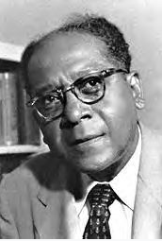
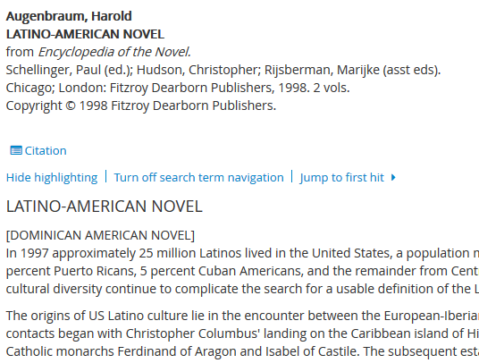
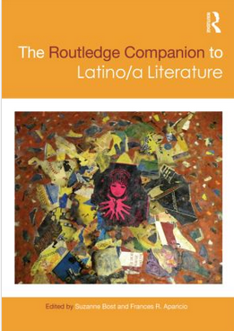
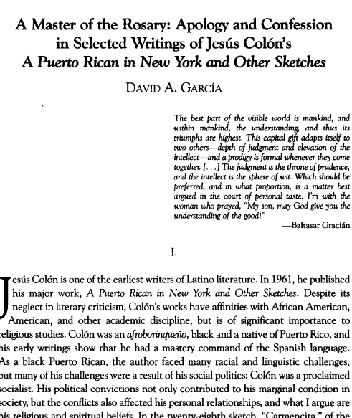
World Literature: more cases
Jesús Colón (1901-74)
Puerto Rican writer; known as the father of the Nuyorican Movement
World Literature Collection brings his complete works, including the influential 1961 work A Puerto Rican in New York, to LION as well as many previously unpublished works.
Contextualised in LION with key reference works, biographies of contemporaries and critical articles

Slide 20
LION on ProQuest – Unique features
Notes:
The following slides will explain the unique tools and features designed especially for Literature Online that are offered on the ProQuest platform.

Slide 21
Literature Online on ProQuest
Platform tools
Brand new Unique pages designed especially for LION:
    Home Page
    Authors Page
    Main Search Results Page
Variant typography searching for detailed textual analysis of early works
Linking and interoperability: users can download and export citations to reference managers, follow outbound OpenURL links and cross search with EEB and other Literary resources (soon EEBO).
Notes:
ProQuest platform users will recognize the main design and many features, but LION includes unique parts which are not available for other databases on the platform.

Slide 22
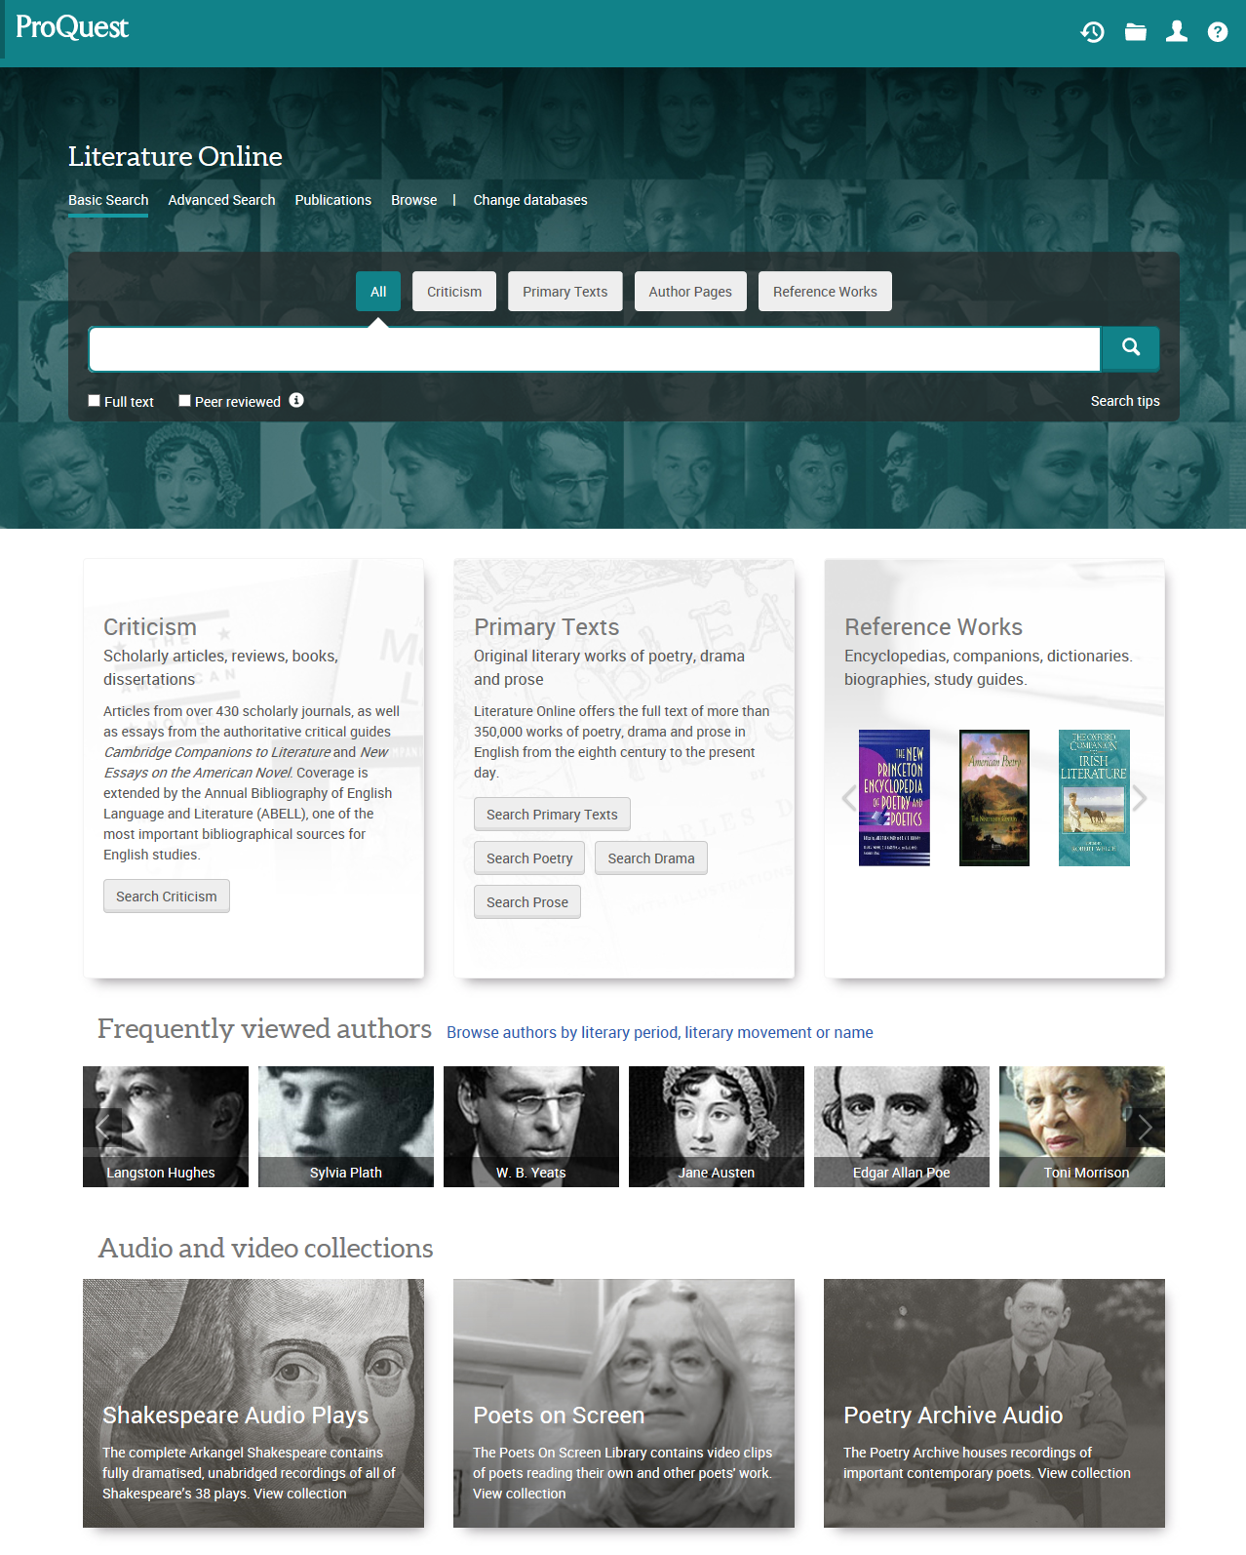
Home Page / Basic Search
Home page provides improved user experience & highlights different content types
easy and quick access to content users may have only stumbled upon in the past
highlights different types of content
Highlights the diversity of authors and works
Notes:
The LION Home page/ Basic search is different to other databases on the ProQuest platform, since it provides an overview of available content, with links to search forms and browse features. Which means it’s a perfect starting point for an introduction to the database. It will also explain which LION collections the institution is currently subscribing to.

Slide 23
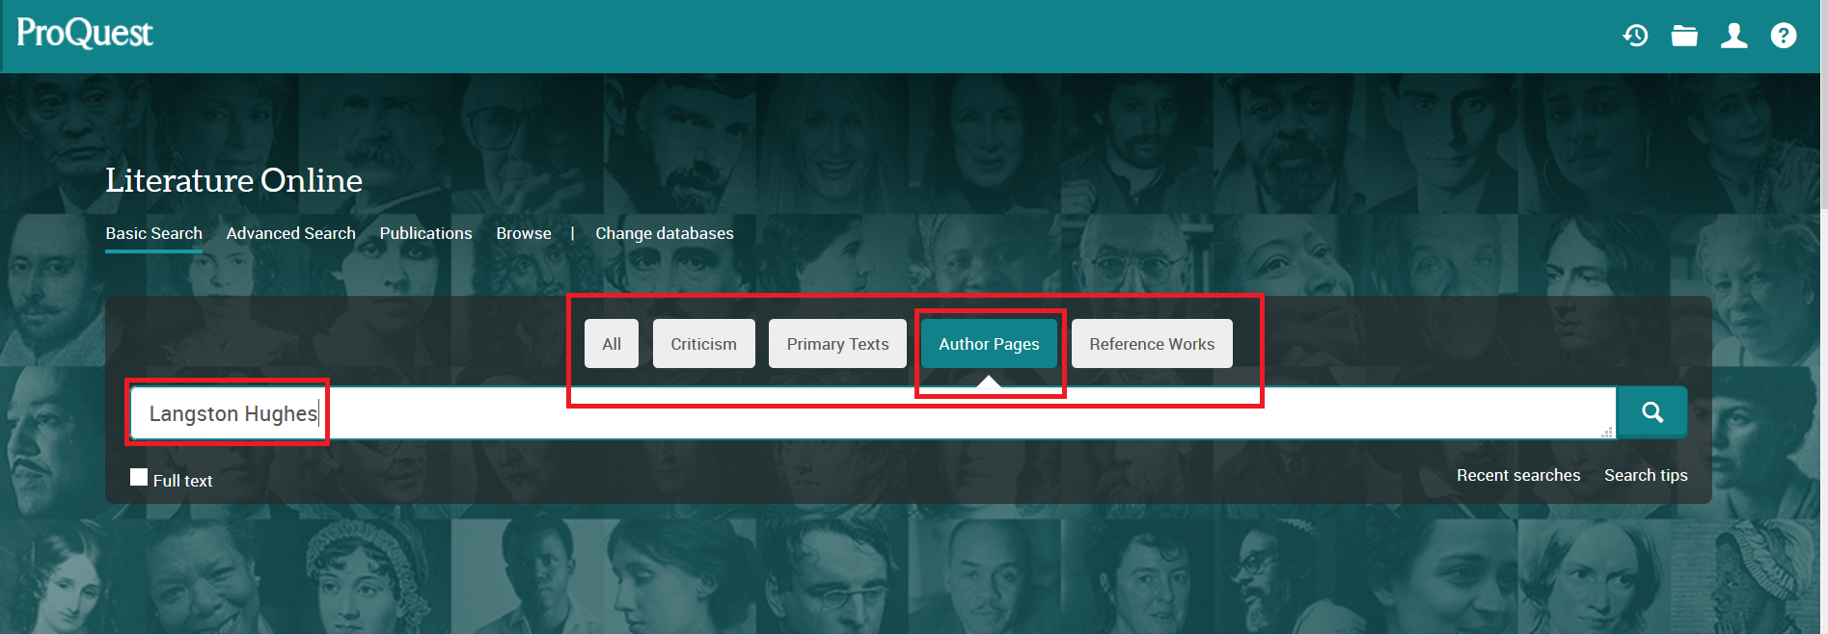
Basic Search
highlights different content types
Notes:
By default, you will search All content in LION. By clicking one of the buttons Criticism, Primary Texts, Author Pages (see example on slide) or Reference Works, you can focus your search on a specific content type.

Slide 24
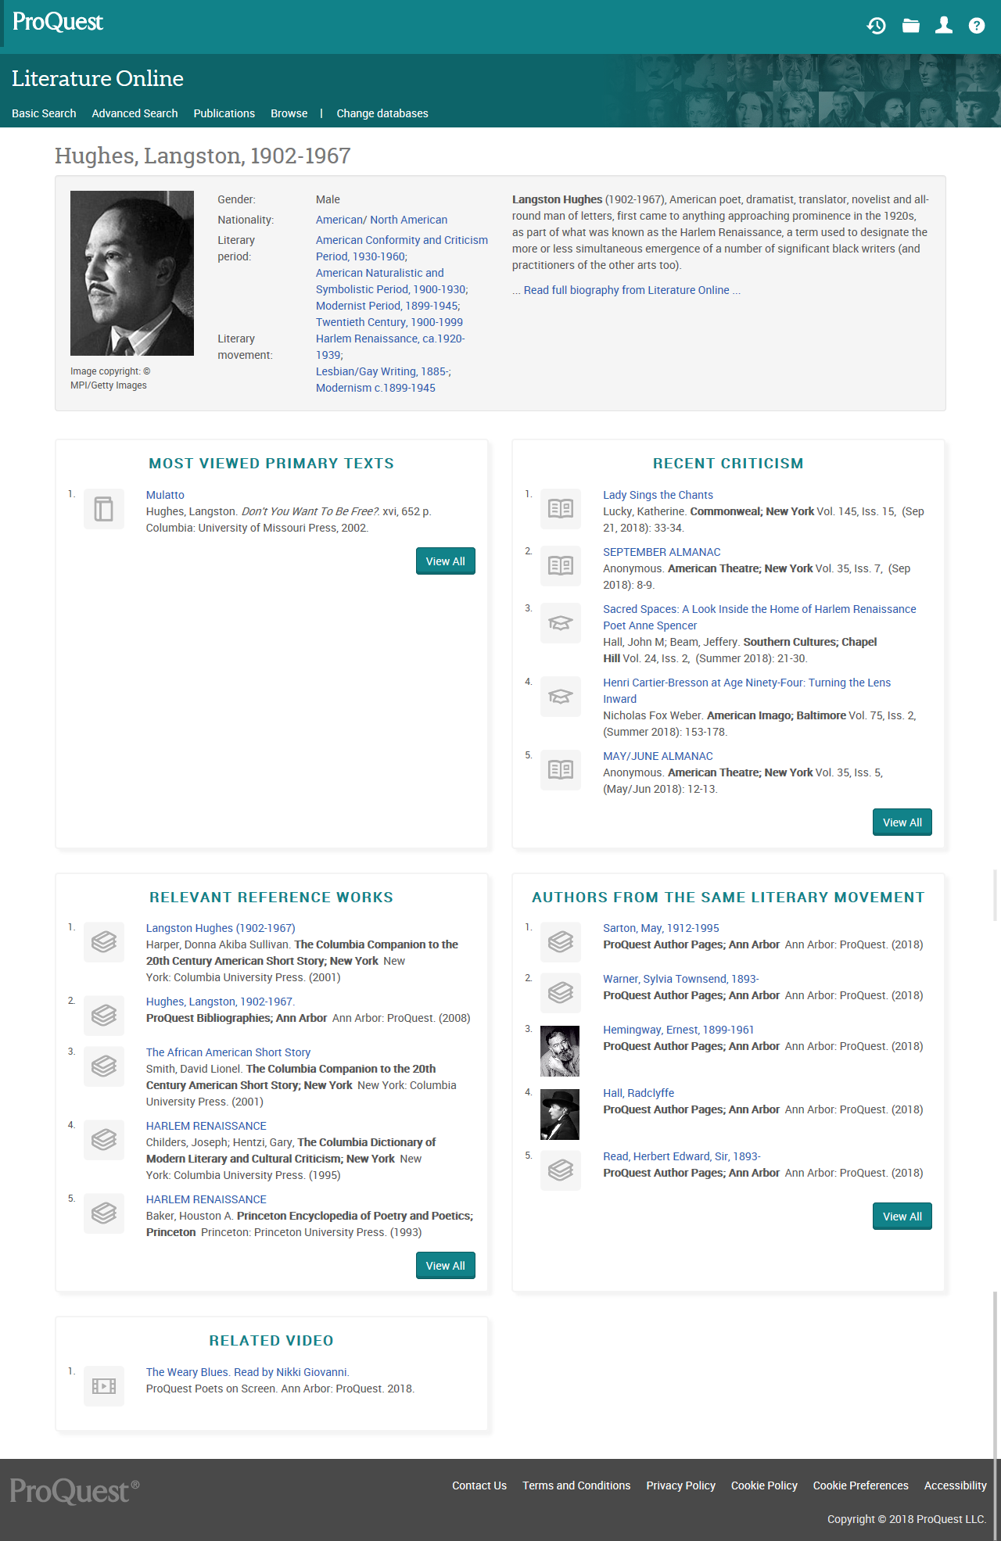
Author Pages
“one-stop” entry point to get all information related to an author
The author is the axis upon which students look to engage with content
Authors are better highlighted within the UX
Pages provide details including:
Biographies
Most viewed primary texts
Most recent criticism
Most relevant reference works
Authors from the same literary movement
Notes:
In a similar way to the Home page/Basic search page, the Author Page is a great starting point for available information in LION. It may contain up to 6 different lists with links to different content types in the database.
(most searches in LION start from looking for authors)
For comparison
Legacy LION:
Minimum indexing on authors
Biographies not linked together
Not well highlighted
Not as much information on the author page
Not as visual

Slide 25
Word Variants searching

Slide 26
Unique Tools - Variant spelling and variant form searching
Wherever possible Literature Online features the first authorized edition of any given literary work and preserves the spelling and punctuation of the copy text.
The spelling of some words has changed over time
A modern-spelling search term will not in itself be adequate to retrieve all the relevant results from historical texts.
Ex: virtue will not retrieve occurrences of vertue;
sensibility will not match with sensibilitie or sensibillity,
honor will not pick up honour.
Notes:
Variant spelling and variant forms searching is a unique feature to ProQuest. This functionality is the result of an ongoing research project at Northwestern University to provide orthographic standardization to a large archive of texts including selected data from Literature Online and EEBO. It is being supported by ProQuest and partner universities.
When searching, you will automatically retrieve all instances of your search term and its variants (spelling, forms, typographic variants, early modern variants) in Literature Online.
For example, if you type the word murder, when you submit your search you will retrieve all occurrences of the word murder and its early modern variants murther, murdre, murdir, and mvrder.
If you type a phrase (for example Keyword(s): “so foul and fair a day”), your results will include instances of the phrase where the spelling varies (such as so foule and faire a day). Similarly, if you type a series of terms connected by Boolean or proximity operators in this field (for example jealous and green-eyed), your search will include all available spelling and typographic variants of each term (such as iealous, greene-eyed and greene eyd).

Slide 27
Unique Tools - Variant spelling and variant form searching
Variant Spelling search functionality enabled by the CIC CLI Virtual Modernization Project
Will retrieve instances of spelling variation
Will automatically search for typographical variants
              v for u
              u for v
              j for i or y
              I for j or y
              y for i or j
              w for vv or uu
              s for f
Ex: jealous
jealous gealous gelous ialouse iealious iealous iealouse ielous jalous jealouse jealouses jealovs jelous

Slide 28
Unique Tools - Variant spelling and variant form searching
The Variant form feature lemmatizes the search terms.
Lemmatization - practice of bundling the different forms of a word under the form in which the word is likely to appear in a dictionary.
Ex: loves, loved and loving are forms of the lemma love.
Lemmatization part of the Virtual Orthographic Standardization project,
allows users to search for the standard lemma love, which would retrieve all variant
forms love, loves, loveth, loving, and loved.
Ex: Jealous
Jealous jealoused jealousest jealously

Slide 29
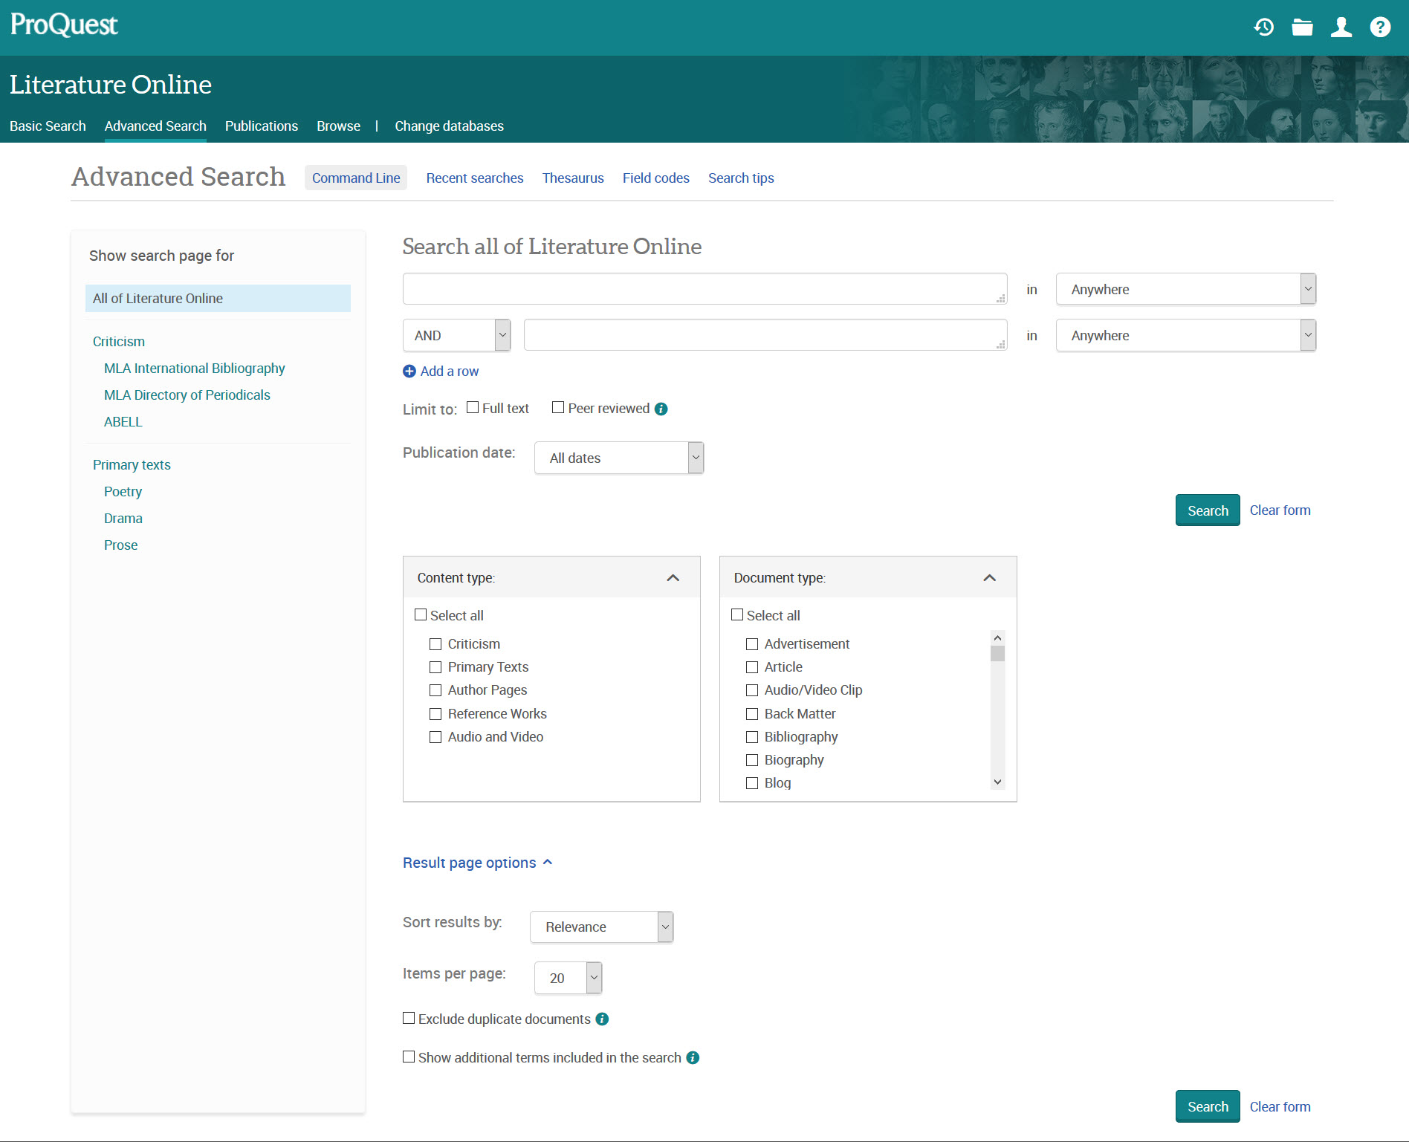
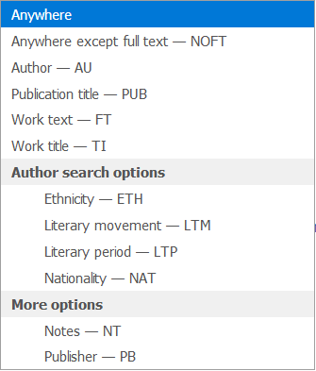
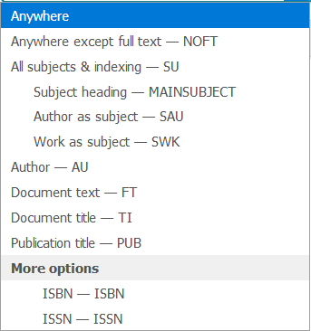
Notes:
By default, you will search All of Literature Online. You can also choose to search only specific content types, eg. Criticism or Primary texts. The selection of searchable fields in the drop down menu will change accordingly.
On the left the list of fields for searching Criticism is shown, on the right is the list of fields for searching the Primary Texts.
On the bottom part of the Advanced search page, click the Result page options link to see additional features.

Slide 30
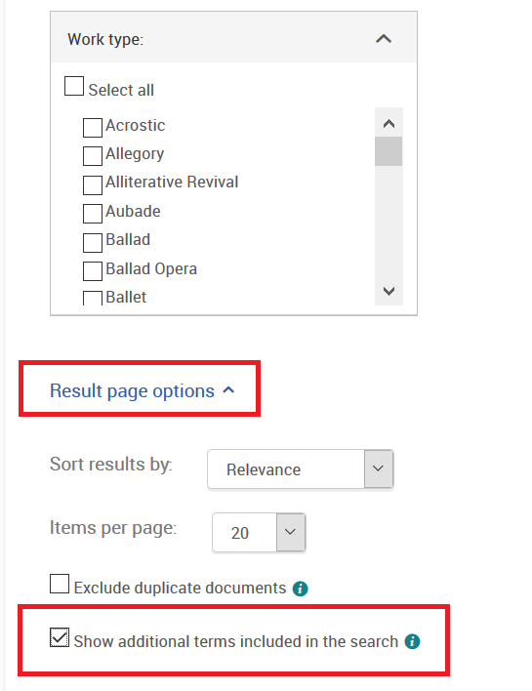
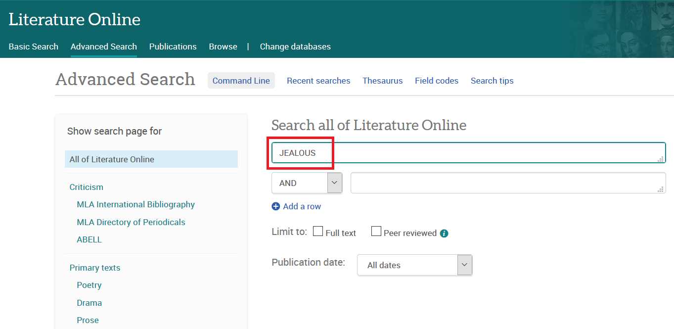
Advanced Search – Variant Forms
Notes:
Add a search term to the advanced search form.
To see the variant spellings and variant forms searching in action,
on the bottom part of the search form, click on the link Result page options, then select Show additional terms included in the search.
Finally click on the Search button.

Slide 31
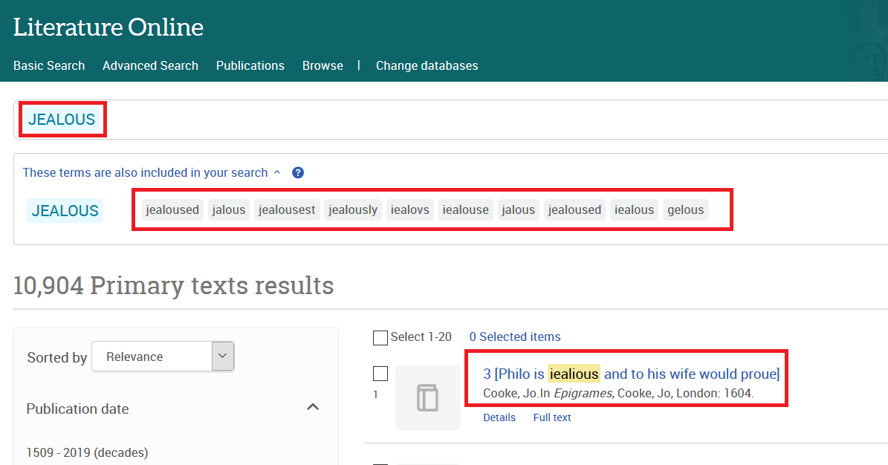
Advanced Search – Variant Forms
Keywords appear in context
Experts can trace word usage
Non experts don’t miss texts which are relevant to their research
Notes:
On top of the result page, you will see a list of the variant forms and variant spellings of your search term that is automatically included in your search.

Slide 32
Unique Results Pages for evaluation

Slide 33
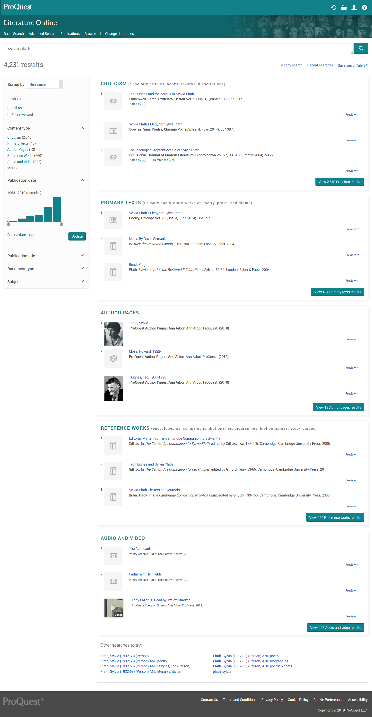
“Main” Search
Results page
Shows the results arranged preliminary by Content Type:
    Criticism
    Primary Texts
    Author Pages
    Reference Works
    Audio and Video (if any)
Click on the View results button to display all the results of that Content Type
Notes:
The LION Main Search results page is another feature that is unique and designed specifically for LION. Depending on your search terms, and the limit options you may have selected on the Basic or Advanced search forms, the result page can include up to 5 content types. Click the green View-button to see the complete result page for each content type.

Slide 34

“Main” Search
Results page
Filtering options now include
  Content type
  Publication date
  Publication title
  Document type
  Subject
Relevant side-panel content
direct users to key author pages
Notes:
The left side-panel on the Main Search results page contains the narrow filters (the content type specific result pages may contain other filters). The right side-panel may direct you to an author page, if matched by your search.

Slide 35

“Texts” Search
Results Page
Filter by
Publication date
Publication title
Author
Literary movement
Literary period
Notes:
The text results page will give you specific filters for primary text records. Your search term is marked in yellow.

Slide 36

“Authors Pages”
Results Page
Filter by
Gender
Nationality
Ethnicity
Literary movement
Literary period
Notes:
This search comes actually from a Basic search with the Author Pages filter preselected. As soon as one of the Content Types filter is used, the narrow filters in the Results page change accordingly. Here those for the Authors apply.

Slide 37


Primary Text
Docview
Navigating between
search keywords
Many more
saving formats
Notes:
More unique features are available when displaying the documents online.
If the article has been located by performing a Primary text keyword search, occurrences of the keyword in the text are highlighted in yellow. Clicking ‘Turn on the search term navigation’ means you can then click on ‘Jump to first hit’ to go to the first occurrence of the keyword in the text. Then use the arrow icon at the first hit to jump to the second hit, etc.
Click the Save link on the right side-panel, to see all available saving formats.

Slide 38
Summary
After this session now you can
Differentiate the various content types based on your research needs
Discover relevant related resources from the Author record page
Use the Word Variants feature for language history researches
Evaluate and refine the search results

Slide 39
Additional Resources & Contact Info
LibGuide https://proquest.libguides.com/lionpqp
Brochure https://www.proquest.com/documents/Literature-Online-Premium-Brochure.html
Contact training@proquest.com for any additional training request
Notes:
Feel free to put links to the libguide on your website, forward and print brochures, and contact ProQuest for training sessions

Slide 40
Include contact information

