Slide 1
Your MarketLine How to Guide

Slide 2
About GlobalData Plc
Diversified Provider of Industry Data and Related Services to >20 Industries Across the Globe
c. $ 200 Million
c. $ 2 Billion
Headquartered in the UK
Listed on AIM (London Stock Exchange)
Annual Revenue
Market Cap
> 4,600 Customers
Americas EU
APAC MENA
UK
RoW
FY22 Revenue by Geography
2

Slide 3
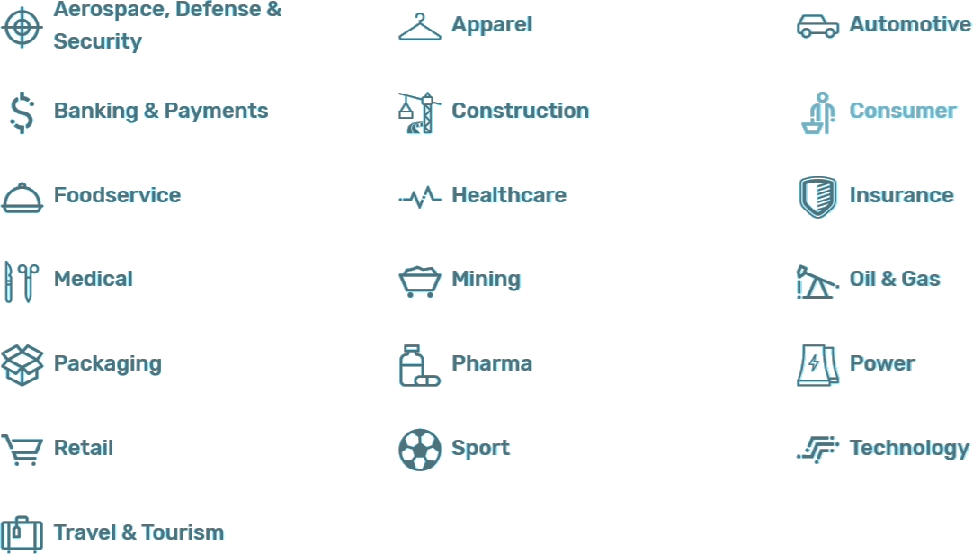
MarketLine is a Provider of Industry Research covering 19 Industries
3

Slide 4
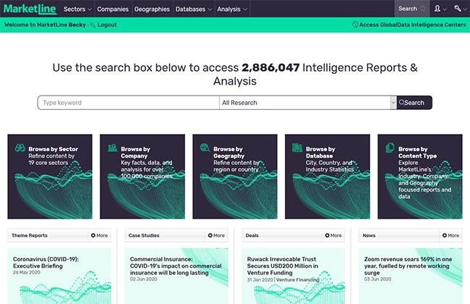
About MarketLine
A truly global service covering every major industry and marketplace in the world.
Industry Data
Company Data
6000+ Industry Profiles including Porter’s
Five Forces Analysis
Market values, volumes, and forecasts for over 120 industry sectors and 50 countries
500,000+ Company Database
100,000+ Company Profiles
12,000 SWOT Analyses
450+ Case Studies highlight best and worst practice
Company News and Financial Deals tracked and updated daily
Product Data
Macroeconomics
Screen companies and build lists of potential business partners, clients, and investment targets from our database of over 500,000 companies
Key socio and macroeconomic indicators for
more than 200 countries and 1950 cities
Country Profiles and City Profiles evaluating Political, Economic, Social, Technological, Legal, and Environmental Factors (PESTLE insights)
Stay informed of market developments with over 600,000 Company News articles and 400,000 Financial Deals
4

Slide 5
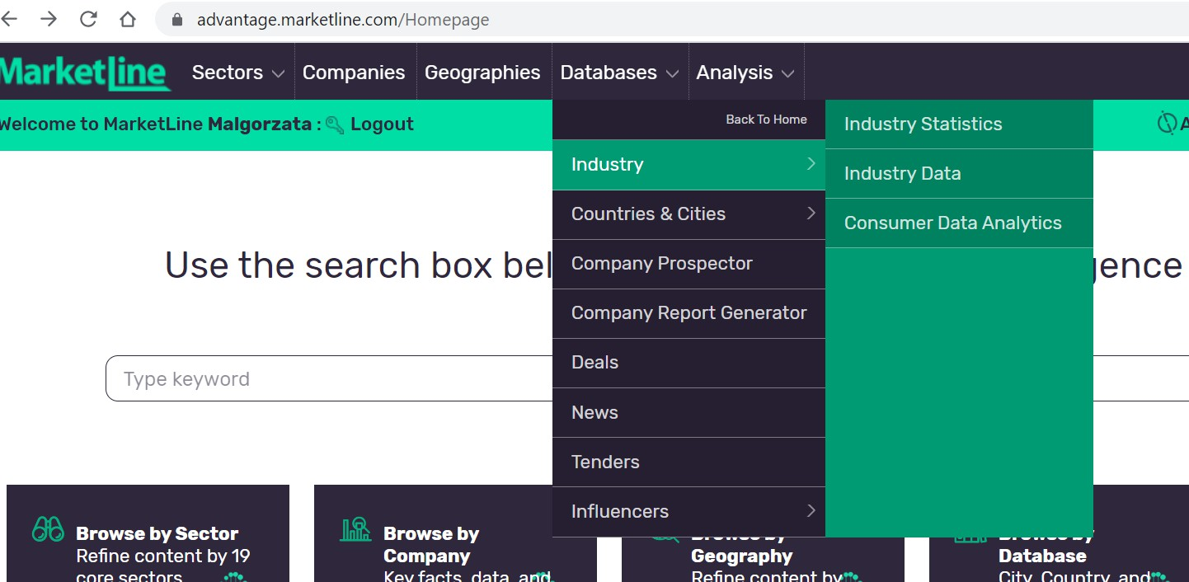
Comprehensive Industry Analysis
Hover over Databases, then Industry to access Industry Statistics and Industry Data

Slide 6
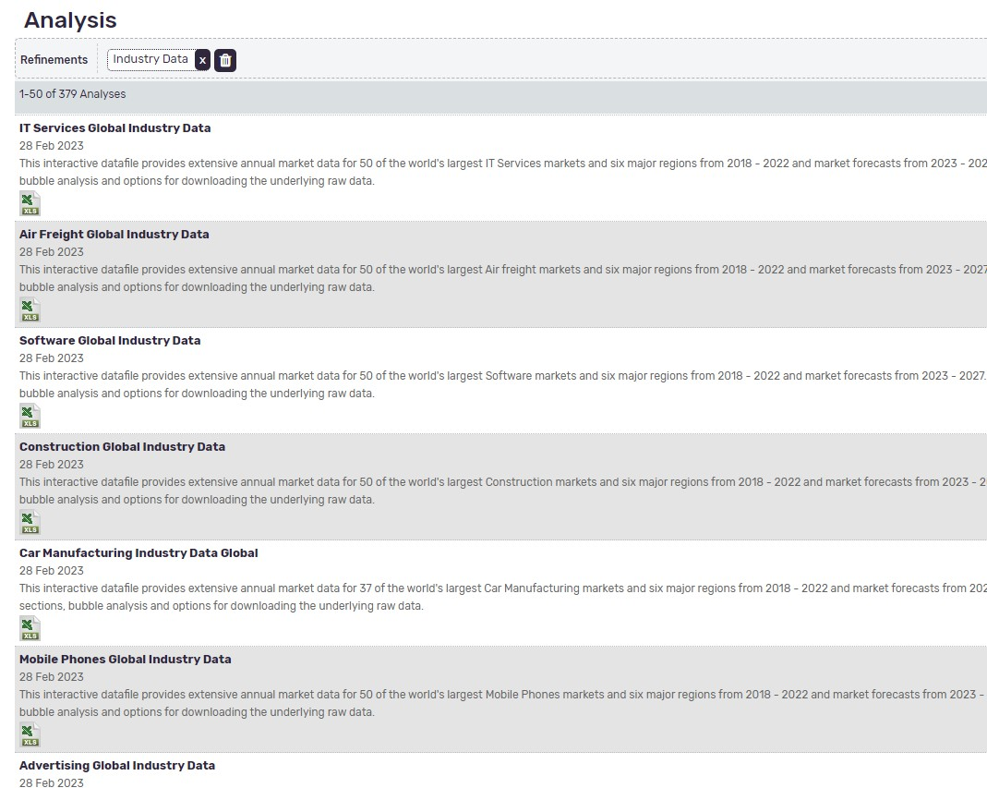
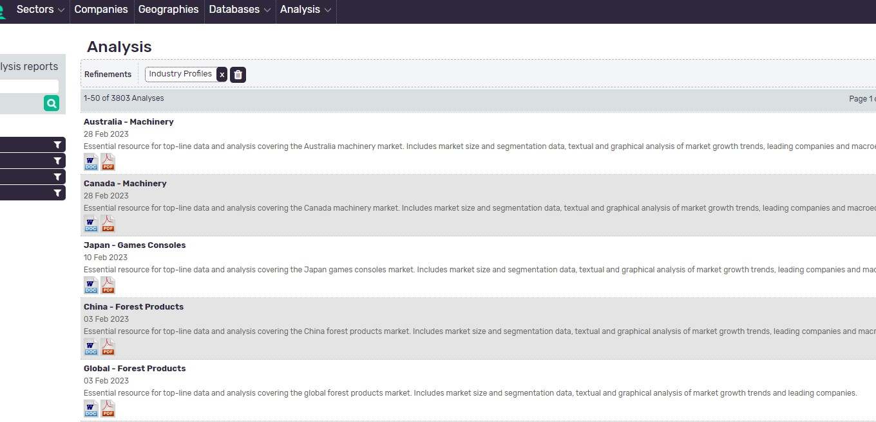
Industry Statistics
Industry Data
You can find the Industry Profiles under the Analysis tab

Slide 7
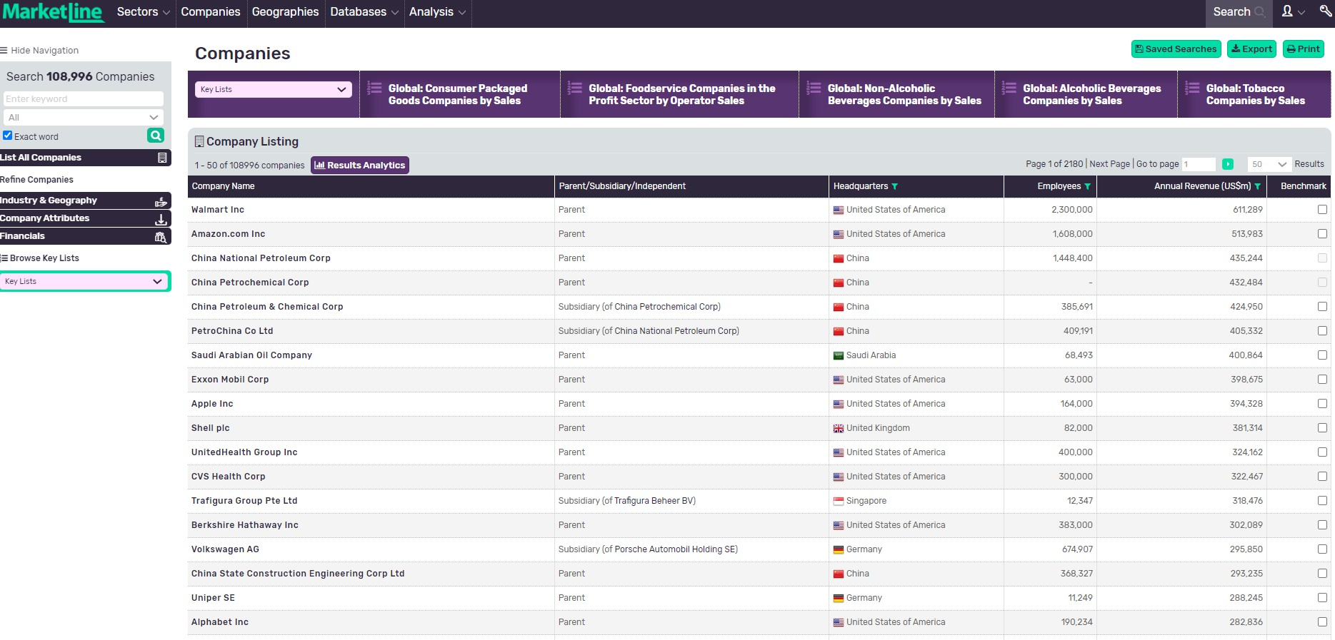
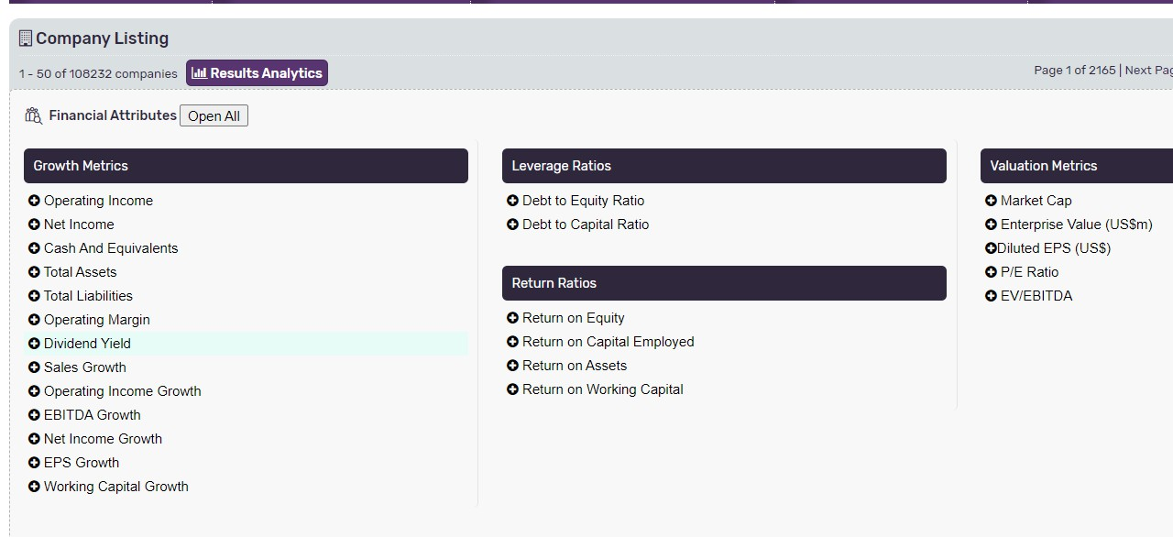
Click on Companies tab at the top to access over 100000 company profiles and pre-made lists. Go to navigation bar on left hand side to refine your search.
Companies: Narrow Down to your Target List
Company Screener Enables Addition of a Wide Range of Criteria to Narrow Down the List to Most Relevant Companies

Slide 8
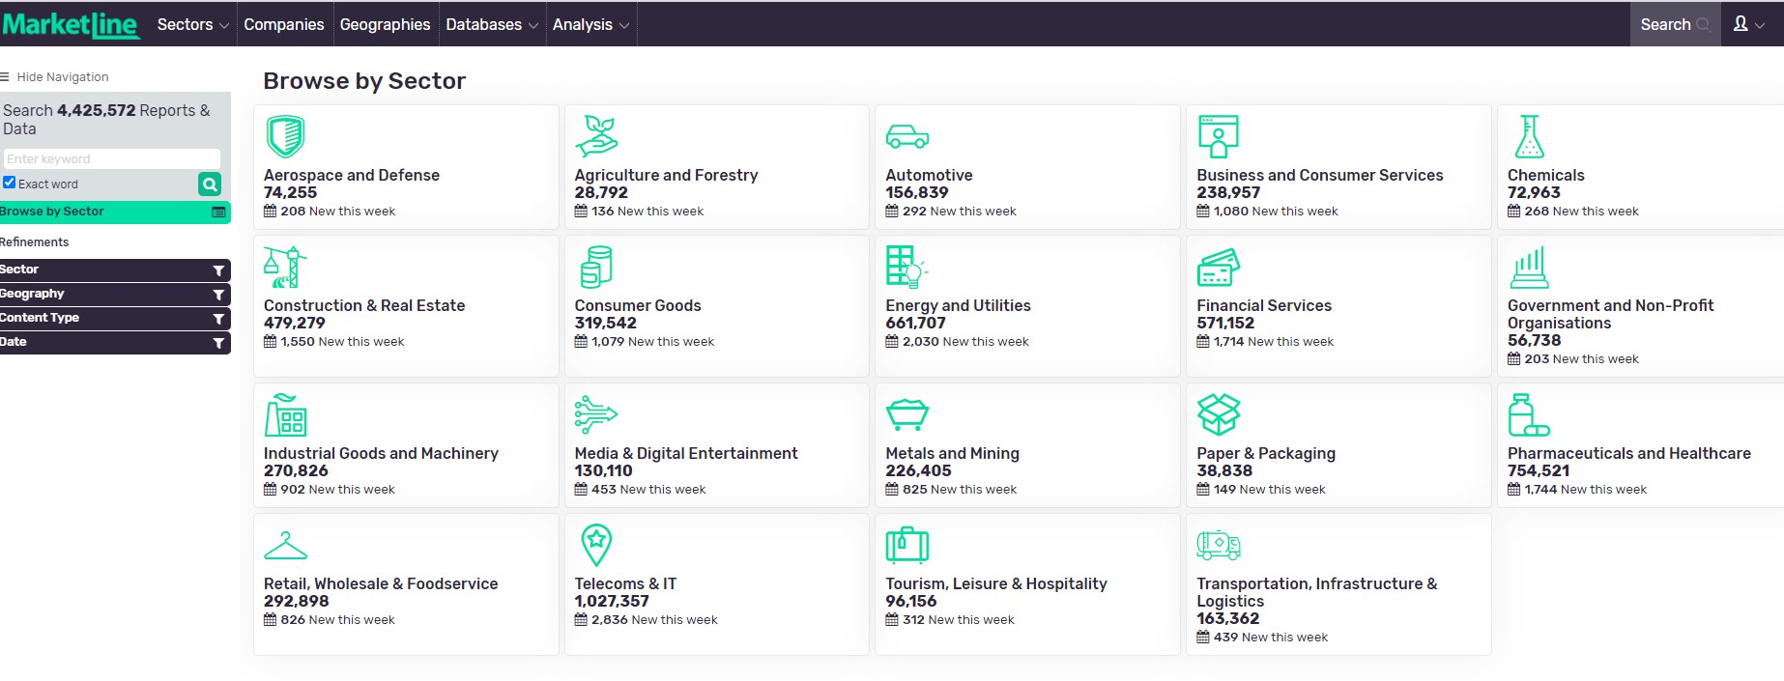
Sector Analysis: Answering Key Questions
Choose your Sector from a drop-down menu or click to view the full list

Slide 9
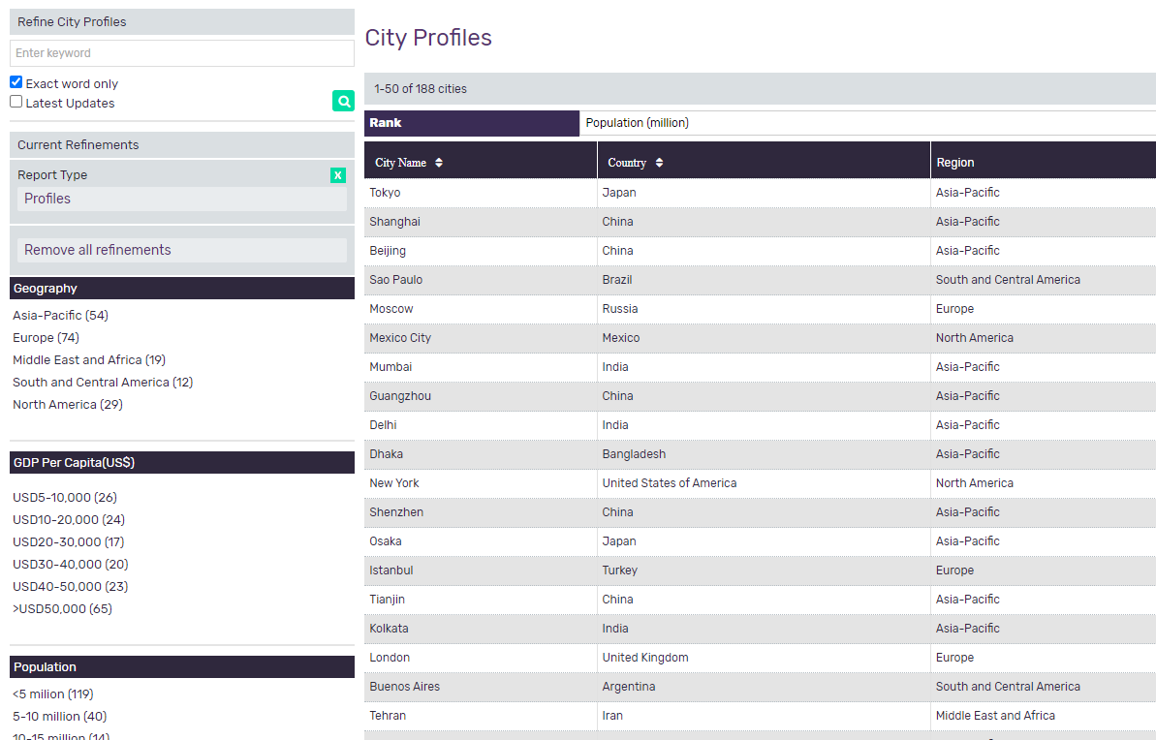
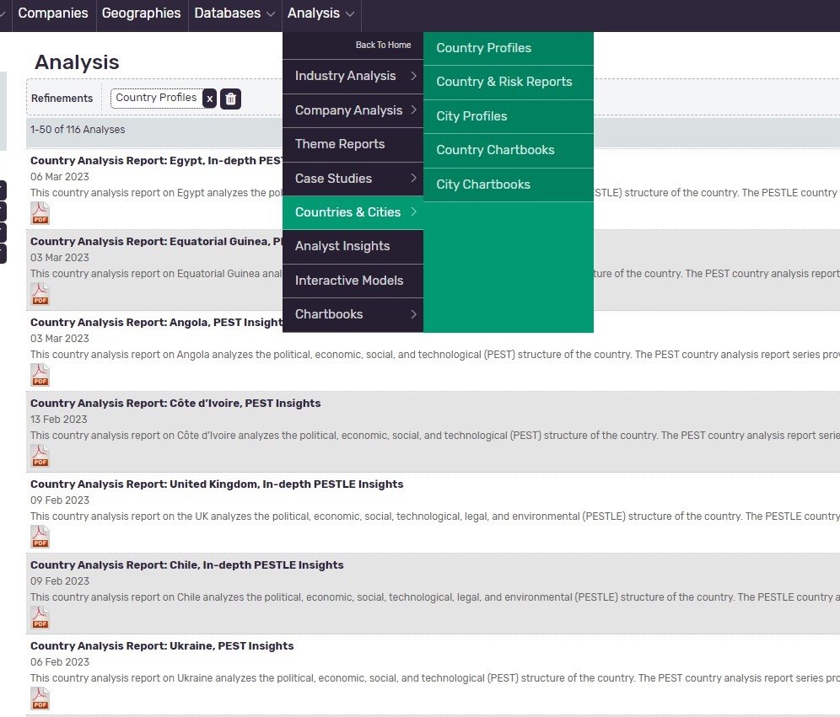
Country and City Analysis
Country Profiles
City Profiles
Navigate to Analysis drop down menu to find Countries & Cities

Slide 10
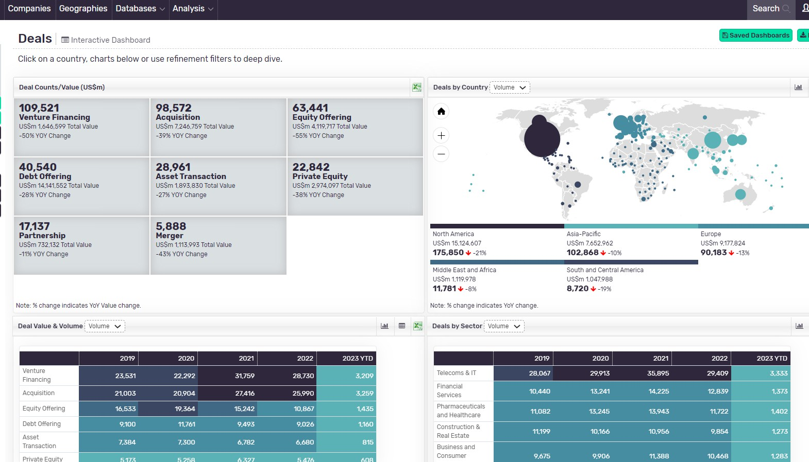
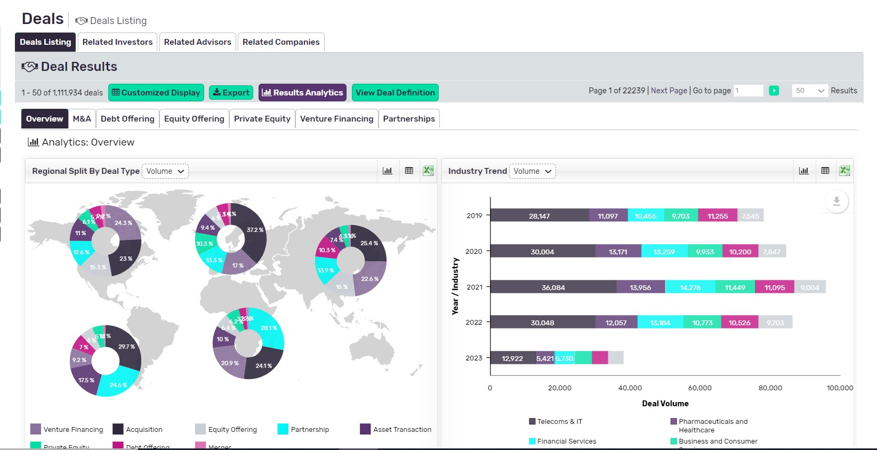
Deals: Zero in on companies that have raised
Financing or looking for Deal-making
Deals
Go to Databases at the top of the page to find Deals and News Dashboard
Analyse industry trends, deal rationale and look at the regional split!

Slide 11
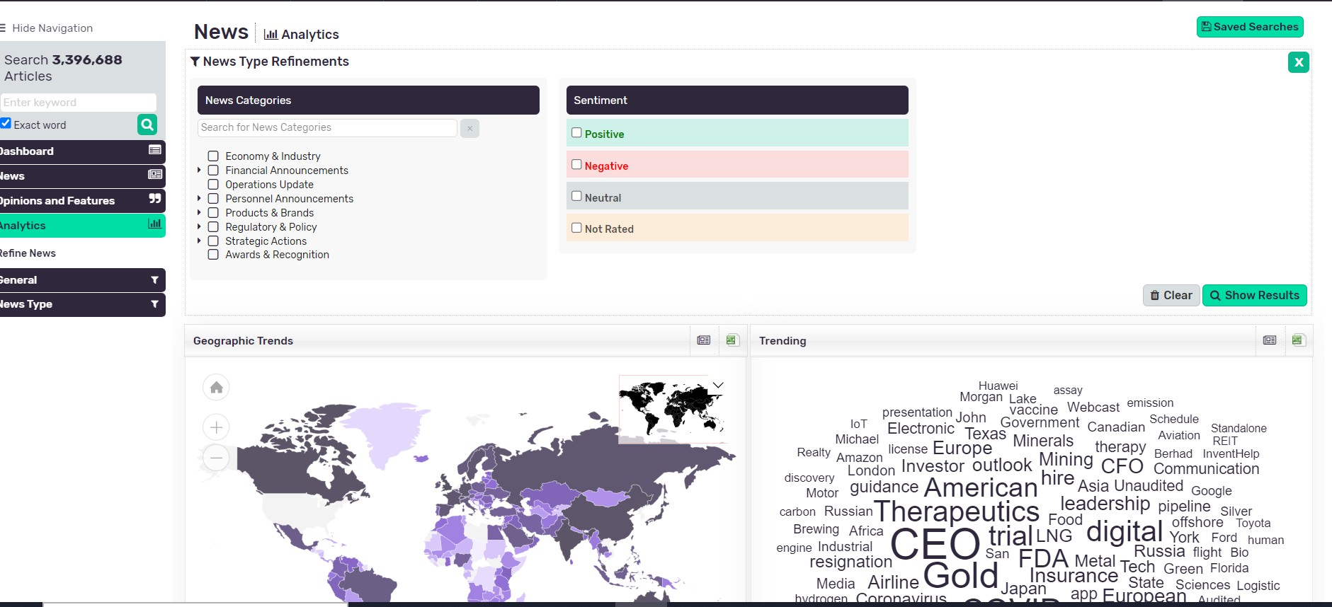
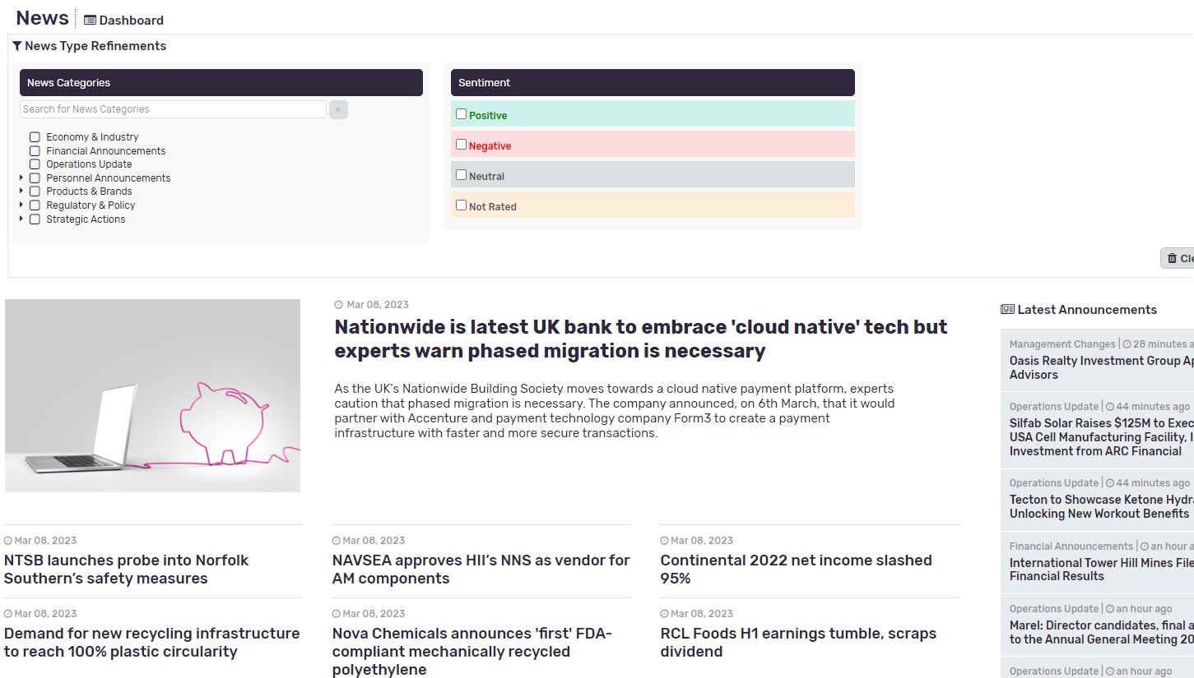
News: Identify your Target based on various events
News
Filter out by news type and sentiment:
positive, negative or neutral!

Slide 12
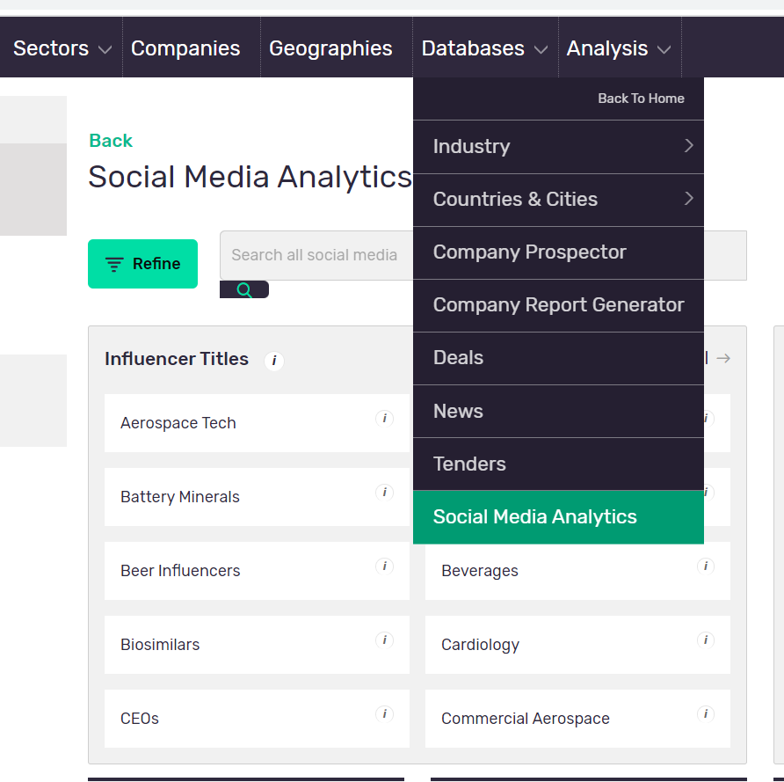
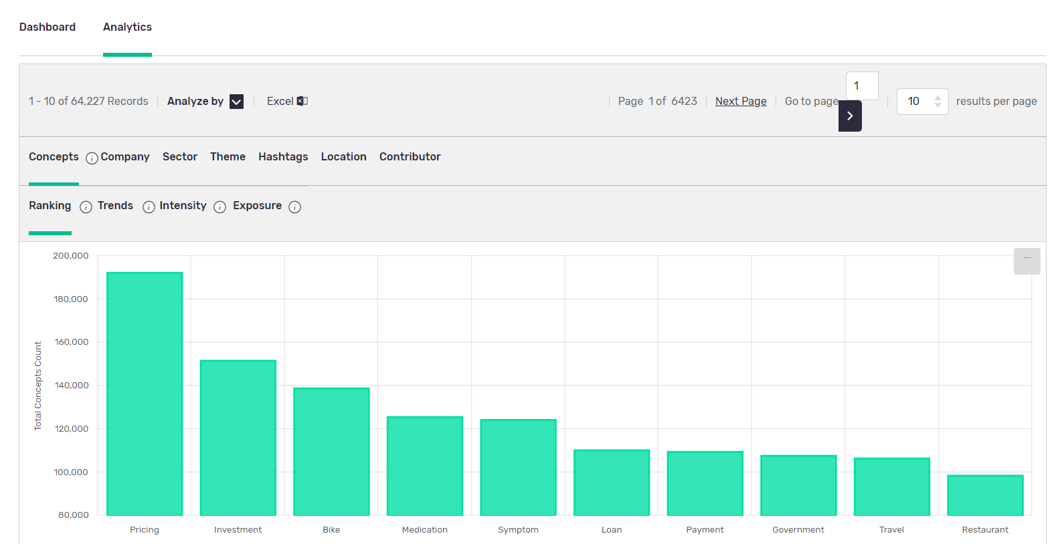
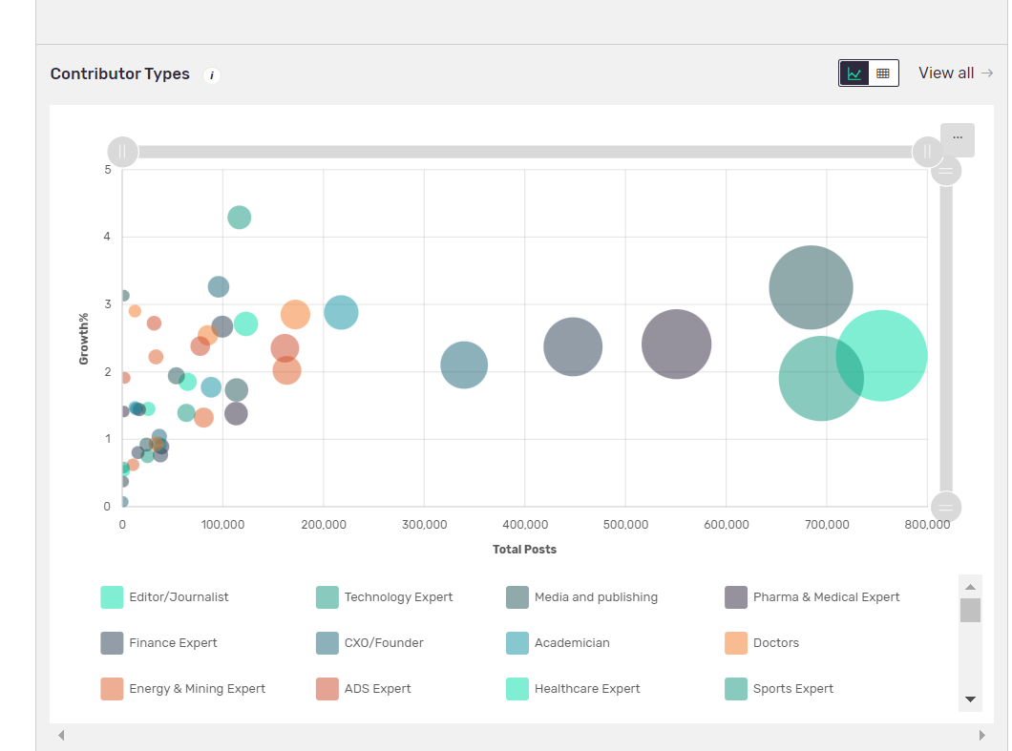
Social Media Analytics: Identify and Evaluate Trending Companies on
Social Platforms
Social Media can be found within the Databases
Analyse top trends by Concepts, Themes, Sectors and more!
Check out the top contributors and influencers as well as top experts!

Slide 13
Training Resources & Queries
Queries & Free Training
If you have any queries regarding MarketLine or wish to arrange free unlimited training, please contact Huyna using email: Huyna.mirandavergara@globaldata.com
For more information on how to use MarketLine please see this online User Guide in PDF format as well as Video Guides for each section of the platform.
13

